Slide 1
Chapter 13: Controller Area Network
The PIC18 Microcontroller
Han-Way Huang
Minnesota State University, Mankato
June 2004

Slide 2
History of CAN
Created in mid-1980s for automotive applications by Robert Bosch.
Design goal was to make automobiles more reliable, safer, and more fuel efficient.
The latest CAN specification is the version 2.0 made in 1991.
Layered Approach in CAN
Only the logical link and physical layers are described.
Data link layer is divided into two sublayers: logical link control (LLC) and medium access control (MAC).
LLC sublayer deals with message acceptance filtering, overload notification, and error recovery management.
MAC sublayer presents incoming messages to the LLC sublayer and accepts messages to be transmitted forwarded by the LLC sublayer.
MAC sublayer is responsible for message framing, arbitration, acknowledgement, error detection, and signaling.
MAC sublayer is supervised by the fault confinement mechanism.

Slide 3
The physical layer defines how signals are actually transmitted, dealing with the description of bit timing, bit encoding, and synchronization.
CAN bus driver/receiver characteristics and the wiring and connectors are not specified in the CAN protocol.
System design can choose from several different media to transmit the CAN signals.

Slide 4
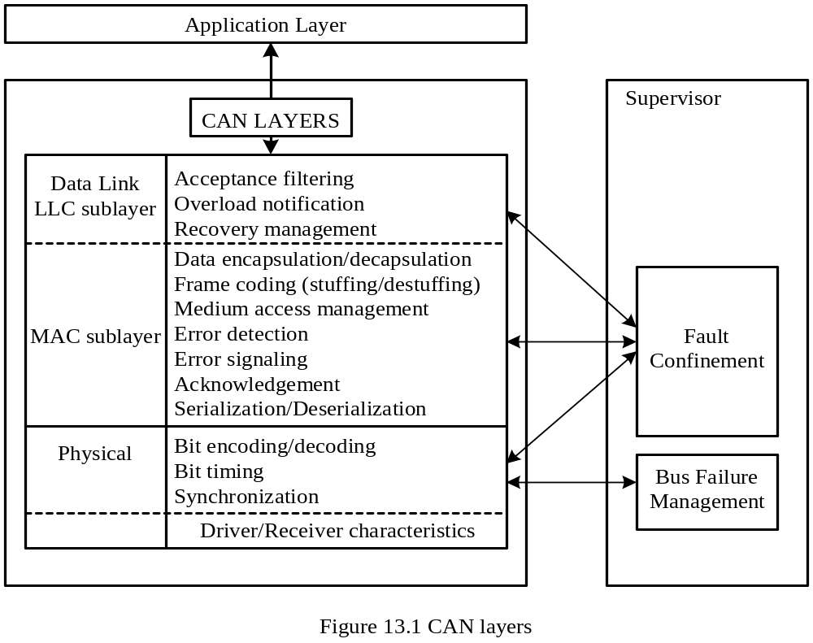

Slide 5
General Characteristics of CAN
Carrier Sense Multiple Access with Collision Detection (CSMA/CD)
1. Every node on the network must monitor the bus (carrier sense) for a period of no activity before trying to send a message on the bus.
2. Once the bus is idle, every node has equal opportunity to transmit a message.
3. If two nodes happen to transmit simultaneously, a nondestructive arbitration method is used to decide which node wins.
Message-Based Communication
1. Each message contains an identifier.
2. Identifiers allows messages to arbitrate and also allow each node to decide whether to work on the incoming message.
3. The lower the value of the identifier, the higher the priority of the identifier.
4. Each node uses one or more filters to compare the incoming messages to decide whether to take actions on the message.
5. CAN protocol allows a node to request data transmission from other nodes.
6. There is no need to reconfigure the system when a new node joins the system.

Slide 6
- Error Detection and Fault Confinement
1. The CAN protocol requires each node to monitor the CAN bus to find out if the bus value and the transmitted bit value are identical.
2. The CRC checksum is used to perform error checking for each message.
3. The CAN protocol requires the physical layer to use bit staffing to avoid long sequence of identical bit value.
Types of CAN Messages
Data frame
Remote frame
Error frame
Overload frame
Two States of CAN Bus
Recessive: high or logic 1
Dominant: low or logic 0

Slide 7
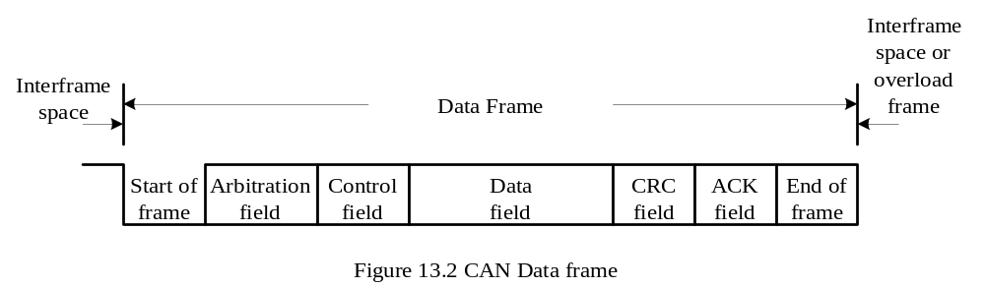
Data Frame
A data frame consists of seven fields: start-of-frame, arbitration, control, data, CRC, ACK, and end-of-frame.
Start of frame
A single dominant bit to mark the beginning of a data frame
All nodes have to synchronize to the leading edge caused by this field

Slide 8
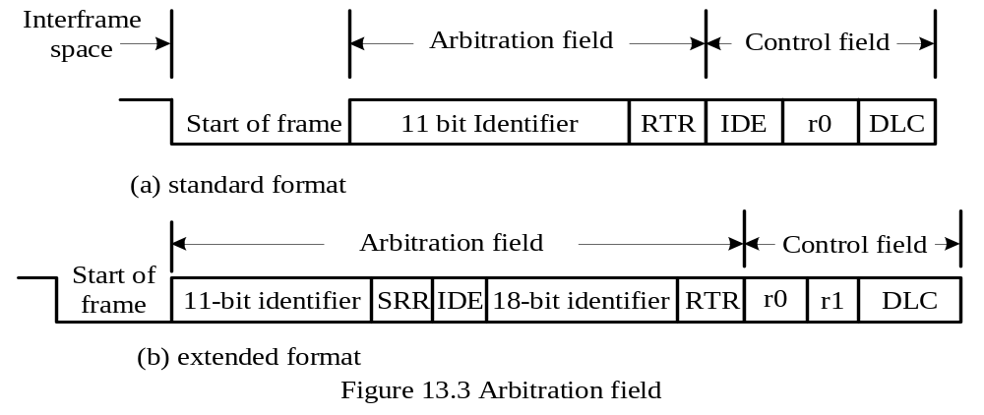
Arbitration Field
- There are two formats for this field: standard format and extended format.
The identifier of the standard format corresponds to the base ID in the extended format.
The RTR bit is the remote transmission request and must be 0 in a data frame.
The SRR bit is the substitute remote request and is recessive.
The IDE field indicates whether the identifier is extended and should be recessive in the extended format.
The extended format also contains the 18-bit extended identifier.

Slide 9
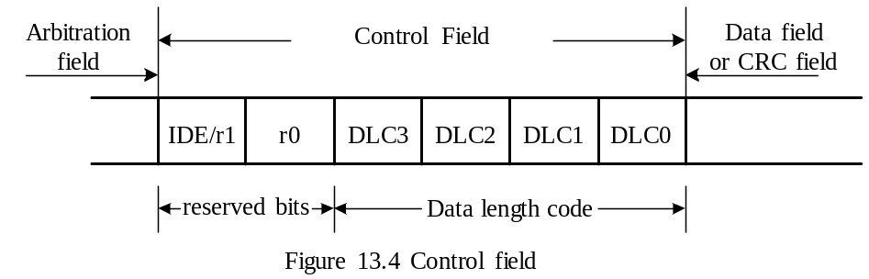
Control Field
Contents are shown in figure 13.4.
The first bit is IDE bit for the standard format but is used as reserved bit r1 in extended format.
r0 is reserved bit
DLC3…DLC0 stands for data length and can be from 0000 (0) to 10000 (8).

Slide 10
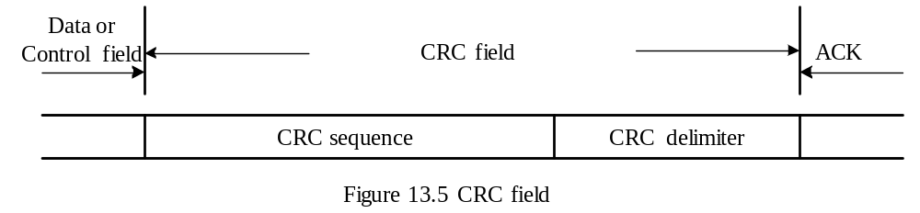
Data Field
- May contain 0 to 8 bytes of data
CRC Field
Contains the 16-bit CRC sequence and a CRC delimiter
The CRC delimiter is a single recessive bit.
ACK Field
Has two bits
The first bit is the acknowledgement bit. This bit is set to recessive by the transmitter but will be reset to dominant if a receiver acknowledges the data frame.
The second bit is the ACK delimiter and is recessive.

Slide 11
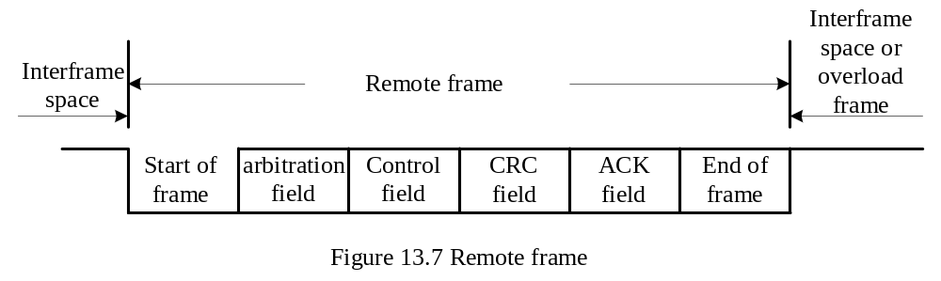
Remote Frame
Used by a node to request other nodes to send certain type of messages.
Has six fields as shown in Figure 13.7.
These fields are identical to those of a data frame with the exception that the RTR bit in the arbitration field is recessive in the remote frame.

Slide 12
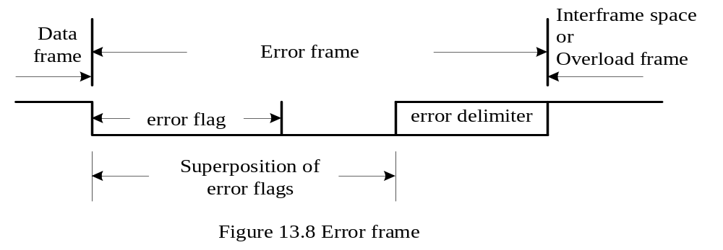
Error Frame
This frame consists of two fields.
The first field is given by the superposition of error flags contributed from different nodes.
The second field is the error delimiter.
Error flag can be either active-error flag or passive-error flag.
Active error flag consists of six consecutive dominant bits.
Passive error flag consists of six consecutive recessive bits.
The error delimiter consists of eight recessive bits.

Slide 13
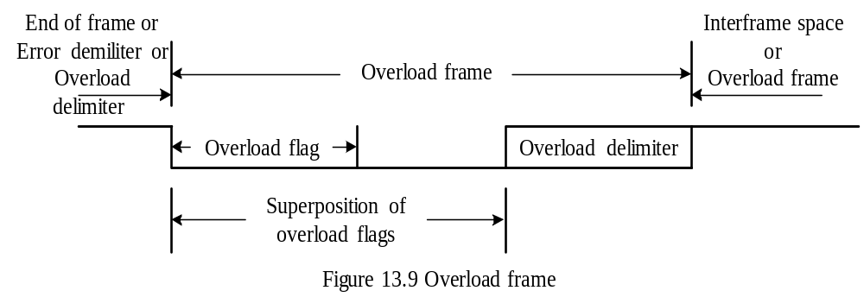
Overload Frame
Consists of two bit fields: overload flag and overload delimiter.
Three different overload conditions lead to the transmission of the overload frame:
1. Internal conditions of a receiver require a delay of the next data frame or remote frame.
2. At least one node detects a dominant bit during intermission.
3. A CAN node samples a dominant bit at the eighth bit (i.e., the last bit) of an error delimiter or overload delimiter.
Format of the overload frame is shown in Figure 13.9.
The overload flag consists of six dominant bits.
The overload delimiter consists of eight recessive bits.

Slide 14
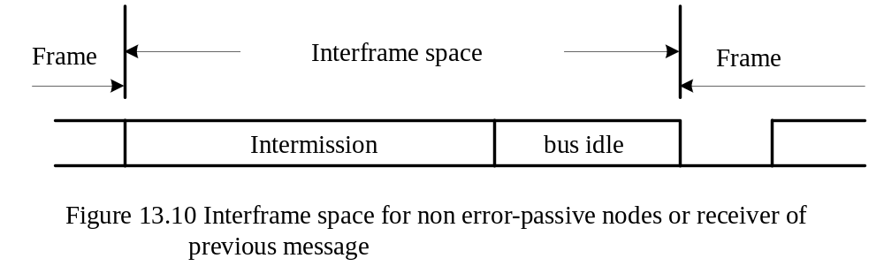
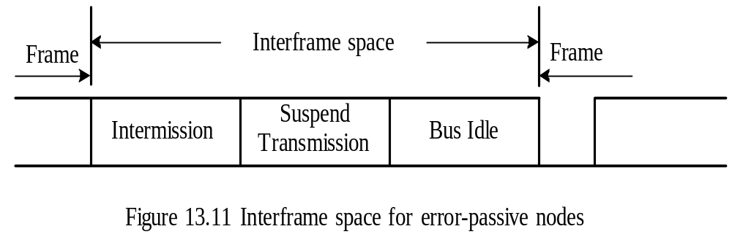
Interframe Space
Data frames and remote frames are separated from preceding frames by the interframe space.
Overload frames and error frames are not preceded by an interframe space.
The formats for interframe space is shown in Figure 13.10 and 13.11.

Slide 15
The intermission subfield consists of three recessive bits.
During intermission no node is allowed to start transmission of the data frame or remote frame.
The period of bus idle may be of arbitrary length.
After an error-passive node has transmitted a frame, it sends eight recessive bits following intermission, before starting to transmit a new message or recognizing the bus as idle.
Message Filtering
A node uses filter (s) to decide whether to work on a specific message.
Message filtering is applied to the whole identifier.
A node can optionally implement mask registers that specify which bits in the identifier are examined with the filter.
If mask registers are implemented, every bit of the mask registers must be programmable.

Slide 16
Bit Stream Encoding
The frame segments including start-of-frame, arbitration field, control field, data field, and CRC sequence are encoded by bit stuffing.
Whenever a transmitter detects five consecutive bits of identical value in the bit stream to be transmitted, it inserts a complementary bit in the actual transmitted bit stream.
The remaining bit fields of the data frame or remote frame (CRC delimiter, ACK field and end of frame) are of fixed form and not stuffed.
The error frame and overload frame are also of fixed form and are not encoded by the method of bit stuffing.
The bit stream in a message is encoded using the non-return-to-zero (NRZ) method.
In the non-return-to-zero encoding method, a bit is either recessive or dominant.

Slide 17
Error Handling
CAN recognizes five types of errors.
Bit Error
A node that is sending a bit on the bus also monitors the bus.
When the bit value monitored is different from the bit value being sent, the node interprets the situation as an error.
There are two exceptions to this rule:
1. A node that sends a recessive bit during the stuffed bit-stream of the arbitration field or during the ACK slot detects a dominant bit.
2. A transmitter that sends a passive-error flag detects a dominant bit.
Stuff Error
- six consecutive dominant or six consecutive recessive levels occurs in a message field.
CRC Error
CRC sequence in the transmitted message consists of the result of the CRC calculation by the transmitter.
The receiver recalculates the CRC sequence using the same method but resulted in a different value. This is detected as a CRC error.

Slide 18
Form Error
Detected when a fixed-form bit field contains one or more illegal bits
Acknowledgement Error
- Detected whenever the transmitter does not monitor a dominant bit in the ACK slot
Error Signaling
A node that detects an error condition signals the error by transmitting an error flag.
An error-active node will transmit an active-error flag.
An error-passive node will transmit a passive-error flag.

Slide 19
Fault Confinement
A node may be in one of the three states: error-active, error-passive, and bus-off.
A CAN node uses an error counter to control the transition among these three states.
CAN protocol uses 12 rules to control the increment and decrement of the error counter.
When the error count is less than 128, a node is in error-active state.
When the error count equals or exceeds 128, the node is in error-passive state.
When the error count equals or exceeds 256, the node is in bus off state.
An error-active node will transmit active-error frame when detecting an error.
An error-passive node will transmit passive-error frame when detecting an error.
A bus-off node is not allowed to take part in bus communication.

Slide 20
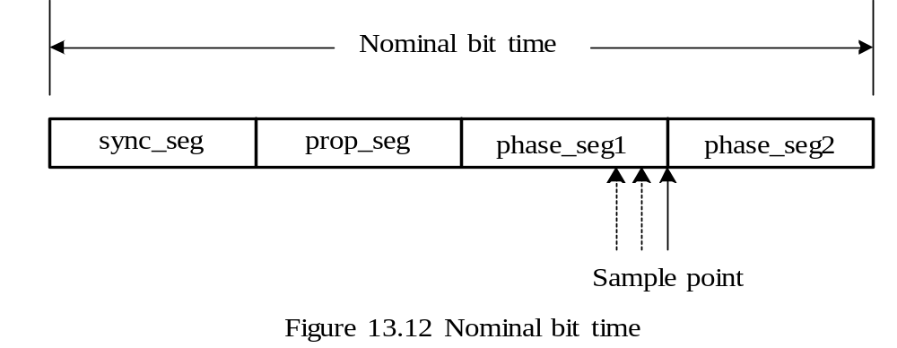
CAN Message Bit Timing
The setting of a bit time in a CAN system must allow a bit sent out by the transmitter to reach the far end of the CAN bus and allow the receiver to send back acknowledgement and reach the transmitter.
The number of bits transmitted per second is defined as the nominal bit rate.
Nominal Bit Time
The inverse of the nominal bit rate is the nominal bit time.
A nominal bit time is divided into four segments as shown in Figure 13.12.

Slide 21
Sync_seg segment
Used to synchronize the various nodes on the bus.
An edge is expected to lie in this segment.
Prop-seg segment
Used to compensate for the physical delay times within the network.
Equals twice the sum of the signal’s propagation time on the CAN bus line, the comparator delay, and the output driver delay.
Phase_seg1 and phase_seg2
Used to compensate for edge phase errors.
Both can be lengthened or shortened by synchronization.
Sample point
At the end of phase1_seg segment.
Users can choose to take three samples instead of one.
A majority function determines the bit value when three samples are taken.
Each sample is separated by half time quantum from the next sample.
The time spent on determining the bit value is the information processing time.

Slide 22
Time Quantum
A fixed unit of time derived by dividing the oscillator period by a prescaler.
Length of Time Segments
sync_seg is 1 time quantum long
prop_seg is programmable to be 1,2,…,8 time quanta long
phase_seg1 is programmable to be 1,2,…,8 time quanta long
phase_seg2 is programmable to be 2,3,…,8 time quanta long
Information processing time is fixed at 2 time quanta for the PIC18.

Slide 23
Synchronization Issue
All CAN nodes must be synchronized while receiving a transmission
The beginning of each received bit must occur during each node’s sync_seg segment.
Synchronization is needed to compensate the difference in oscillator frequencies of each node, the change in propagation delay and other factors.
Two types of synchronizations are defined: hard synchronization and resynchronization.
Hard synchronization is performed at the beginning of a message frame, when each CAN node aligns the sync_seg of its current bit time to the recessive-to-dominant transition.
Resynchronization is performed during the remainder of the message frame whenever a change of bit value from recessive to dominant occurs outside the expected sync_seg segment.

Slide 24
Resynchronization Jump Width
The incoming recessive to dominant edge can occur
1. After the sync_seg segment but before the sample point. This is a late edge. A node will attempt to resynchronize by increasing the length of phase_seg1 segment.
2. After the sample point but before the sync_seg segment of the next bit. This is a early bit. The node will attempt to resynchronize by shortening the duration of phase_seg2 segment.
3. Within the sync_seg segment of the current bit time. No synchronization error.
The amount of adjustment that can be made to the phase_seg1 or phase_seg2 is limited by the resynchronization jump width.
The resynchronization jump width is programmable to be between 1 and the smaller of 4 and phase_seg1 time quanta.

Slide 25
PIC18 CAN Module
The PIC18C658/858, PIC18F248/258/448/458, and PIC18F6585/8585/6680/8680 have on-chip CAN controller.
The CAN controller in the PIC18C658/858 and the PIC18F248/258/448/458 has one operation mode (mode 0) only.
The CAN controller in the PIC18F6585/8585/6680/8680 has three operation modes: mode 0, mode 1. and mode 2.
The CAN modules in PIC18CXX8 and PIC18FXX8 uses two pins (CANTX and CANRX) to transmit and receive data.
The CAN module in the PIC18F6585/8585/6680/8680 uses three pins (CANTX1, CANRX, and CANTX2) to interface with the CAN bus.
The CANTX2 pin can be programmed to carry the CAN clock signal or the complement of the CANTX1 signal and will be useful to debug or drive those CAN transceivers that need the complement of CANTX1.
A typical CAN system is shown in Figure 13.13.

Slide 26
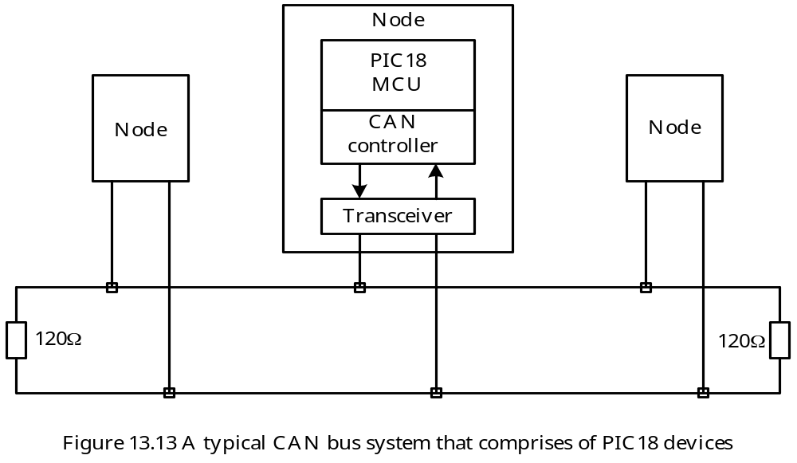

Slide 27
CAN Modes of Operation
1. Configuration mode
2. Normal mode
3. Disable mode
4. Listen-only mode
5. Loopback mode
6. Error recognition mode
All modes except the error recognition mode are entered by programming the CANCON register.
The error recognition mode is entered by programming the RXM bits of the receive buffer control registers RXB0CON and RXB1CON.
Only a subset of the CAN registers are in access bank. The WIN2…WIN0 bits selects the CAN buffer to switch into the access bank.
After a frame has caused an interrupt, the ICODE3:ICODE0 bits can be copied to the WIN3:WIN0 bits to select the correct buffer.
When changing modes, the mode will not actually change until all pending transmissions are complete.
The user must check the OPMODE bits of the CANSTAT register to verify that the new mode has been entered before performing any further operation.

Slide 28
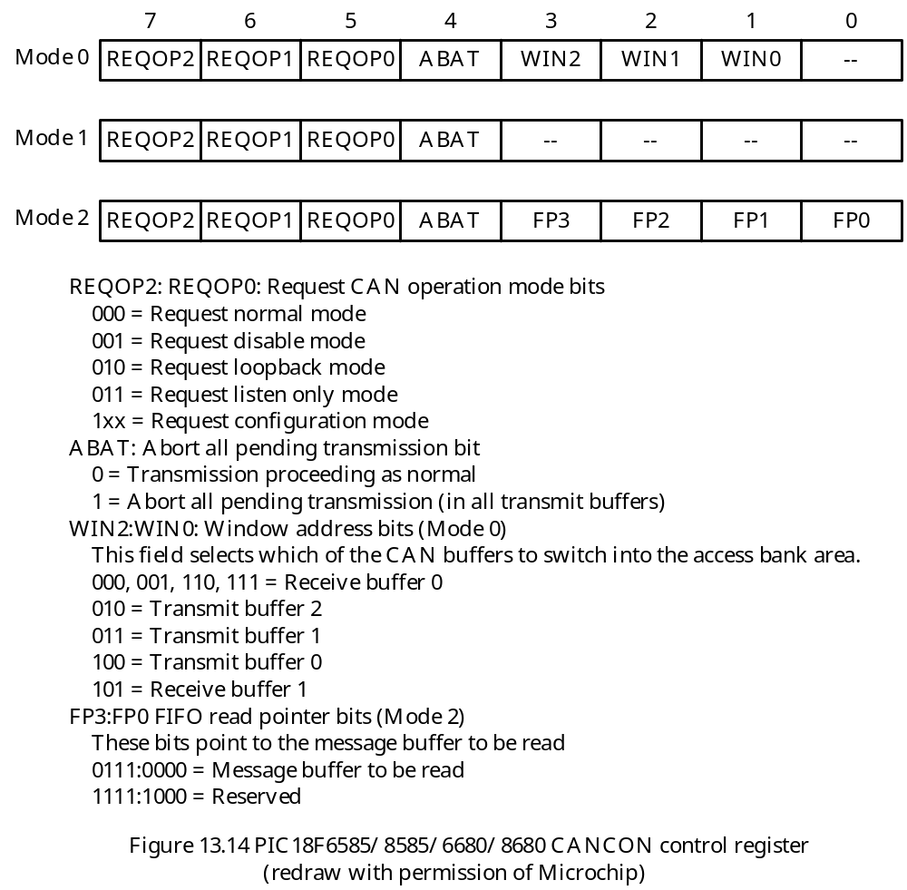

Slide 29
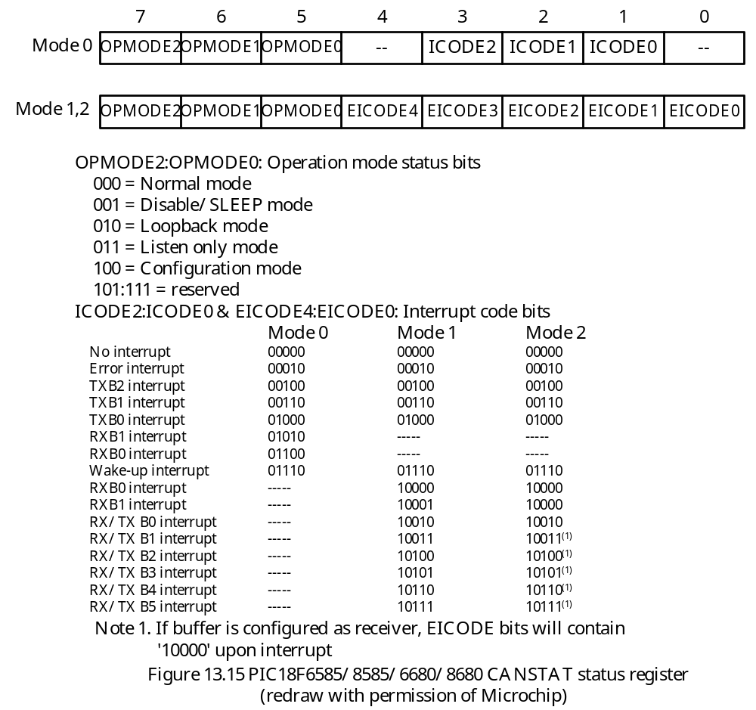

Slide 30
- When interrupt occurs, the prioritized interrupt code will be present in ICODE2~ICODE0 (mode 0) or EICODE4~EICODE0 (mode 1 or mode 2).
By copying ICODE2~ICODE0 to WIN3~WIN0 (mode 0) or copying EICODE4~EICODE0 into EWIN4~EWIN0 of the ECANCON register (mode 1 and mode 2), the correct buffer can be mapped into the access bank.
Example 13.1 Write an instruction sequence to set the CAN module to configuration mode.
Solution:
movlw 0x80
movwf CANCON,A ; set to configuration mode
config_wt movf CANSTAT,W,A ; read current mode state
andlw 0x80
bz config_wt ; if not configuration mode, branch
…

Slide 31
Configuration Mode
The initialization of CAN module can only be done in this mode.
After the CAN module has been initialized properly, the user will want to switch to normal mode to perform normal operation.
The following registers can only be modified in configuration mode:
1. Configuration registers
2. Functional mode selection registers
3. Bit timing registers
4. Identifier acceptance filter registers
5. Identifier acceptance mask registers
6. Filter and mask control registers
7. Mask selection registers
- CAN will neither transmit nor receive messages in this mode.

Slide 32
Disable Mode
In this mode, CAN module will not transmit or receive.
This mode causes the module internal clock to stop unless the module is active.
If the module is active, the module will wait for 11 recessive bits on the CAN bus, detect that condition as an IDLE bus, then accept the module disable command.
If the wakeup interrupt is enabled in this mode, then a CAN bus activity interrupt (indicating by the setting of WAKIF flag) can wakeup the CAN module.
Normal Mode
The only mode in which the PIC18 CAN devices will transmit messages over the CAN bus.
Listen-Only Mode
Allow PIC18 devices with CAN to receive all messages, including messages with errors.
This mode can be used for bus monitoring or for detecting the baud rate in hot plugging applications.
No messages will be transmitted in this mode.
Baud rate can be detected empirically in this mode.

Slide 33
Loopback Mode
This mode allows internal transmission of messages from the transmit buffers to the receive buffers without actually transmitting messages on the CAN bus.
This mode is mainly used in system development and testing.
The filters and masks can be used to allow particular messages to be loaded into receive registers.
Error-Recognition Mode
In this mode, the CAN module can ignore all errors and receive any message.
This mode is activated by setting the RXM<1:0> bit in the RXBnCON registers to 11.
The data that is in the message assembly buffer until the error time, is copied into the receive buffer and can be read via the CPU interface.

Slide 34
CAN Module Registers
The CAM module contains several hundred registers.
These registers are divided into seven groups:
1. Control and status registers
2. Dedicated transmit buffer registers
3. Dedicated receive buffer registers
4. Programmable TX/RX and Auto RTR buffers
5. Baud rate control registers
6. I/O control registers
7. Interrupt status and control registers
The enhanced CAN module of the PIC18F6585/8585/6680/8680 adds an additional control register ECANCON and an additional status register COMSTAT to implement the additional features.
The contents of ECANCON and COMSTAT are shown in Figure 13.16 and 13.17.

Slide 35
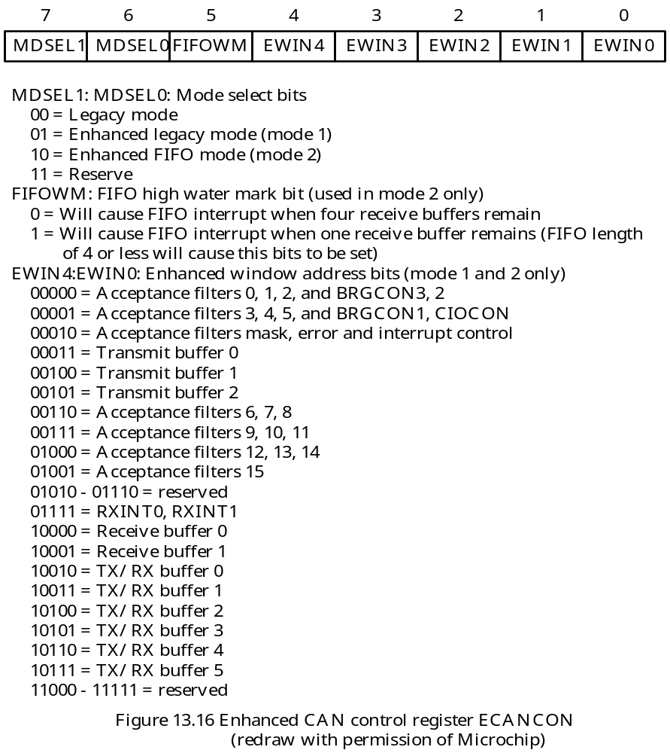

Slide 36
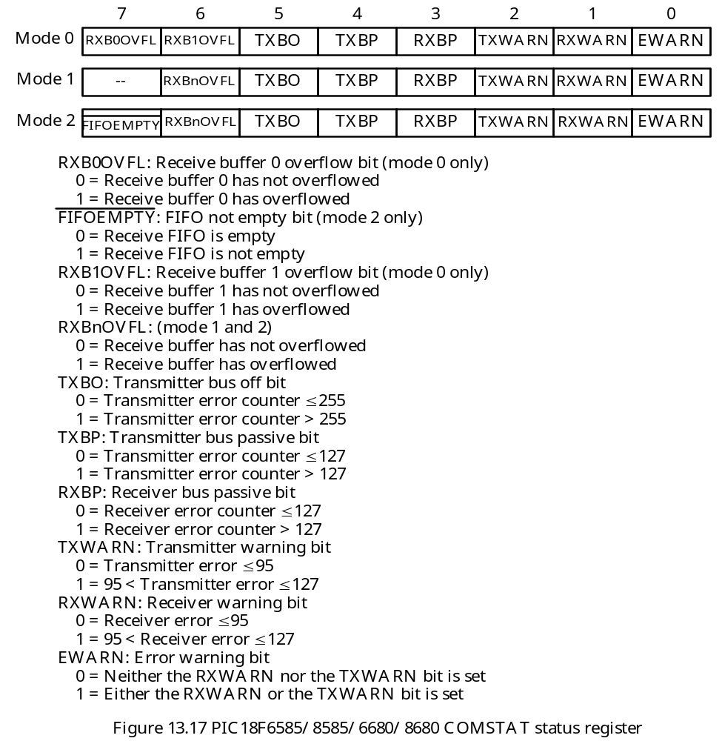

Slide 37
CAN Module Functional Modes
Mode 0—Legacy Mode
Compatible throughout all PIC18 CAN devices
Hardware resources:
1. Three transmit buffers: TXB0, TXB1, and TXB2
2. Two receive buffers: RXB0 and RXB1
3. Two acceptance masks, one for each receive buffer: RXM0 and RXM1
4. Six acceptance filters: RXF0~RXF5. RXF0 and RXF1 are for RXB0; RXF2, RXF3, RXF4, and RXF5 are for RXB1.

Slide 38
Mode 1—Enhanced Legacy Mode
- More resources than mode 0
Hardware resources:
1. Three dedicated transmit buffers: TXB0, TXB1, and TXB2
2. Two dedicated receive buffers: RXB0 and RXB1
3. Six buffers programmable as TX or RX: B0 – B5
4. Automatic remote request (RTR) handling on B0 to B5
5. Sixteen dynamically assigned acceptance filters: RXF0 – RXF15.
6. Two dedicated acceptance mask registers and one RXF15 programmable as third: RXM0, RXM1, RXF15.
7. Programmable data filter on standard identifier messages: SDFLC, useful for DeviceNet protocol.

Slide 39
Mode 2 – Enhanced FIFO Mode
Two or more receive buffers are used to form the receive FIFO.
There is no one-to-one relationship between the receive buffer and acceptance filter registers.
Any filter that is enabled and linked to any FIFO receive buffer can generate acceptance and cause FIFO to be updated.
FIFO length is user programmable, from 2 to 8 buffers deep.
This mode has the following hardware resources:
1. Three transmit buffers: TXB0, TXB1, and TXB2
2. Two receive buffers: RXB0 and RXB1
3. Six buffers programmable as TX or RX; receive buffers form a FIFO: B0 – B5
4. Automatic RTR handling on B0 – B5
5. Sixteen acceptance filters: RXF0 – RXF15
6. Two dedicated acceptance mask registers – RXM0 and RXM1; RXF15 programmable as third mask
7. Programmable data filter on standard identifier messages: SDFLC, useful for DeviceNet protocol

Slide 40
Dedicated Transmit Buffers
The CAN module has three dedicated transmit buffers: TXB0, TXB1, and TXB2.
Each transmit buffer has 14 bytes of registers and are mapped to SFR memory map:
1. One transmit buffer control register TXBnCON
2. Four identifier registers: TXBnSIDL, TXBnSIDH, TXBnEIDL, TXBnEIDH
3. One data length count register TXBnDLC
4. Eight data byte registers: TXBnDm, n = 0,…,2; m = 0,1….,7
- The contents of TXBnCON is shown in Figure 13.18.

Slide 41
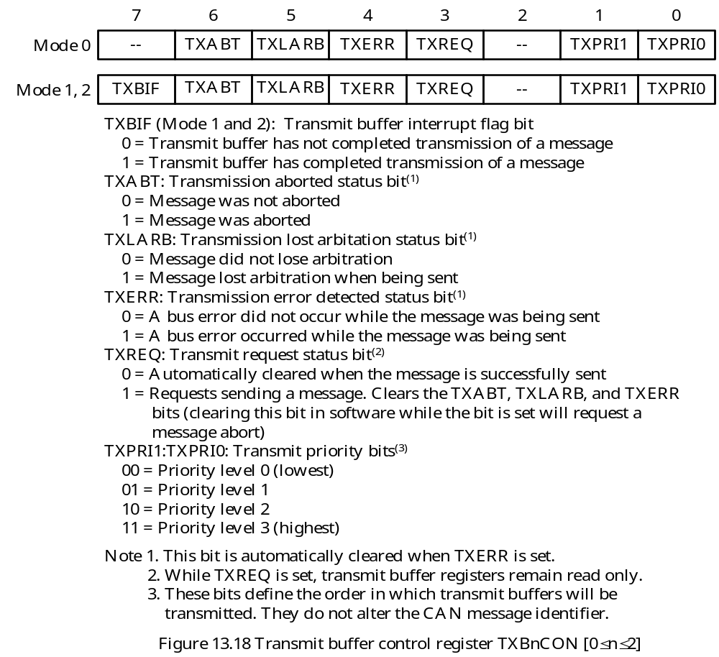

Slide 42
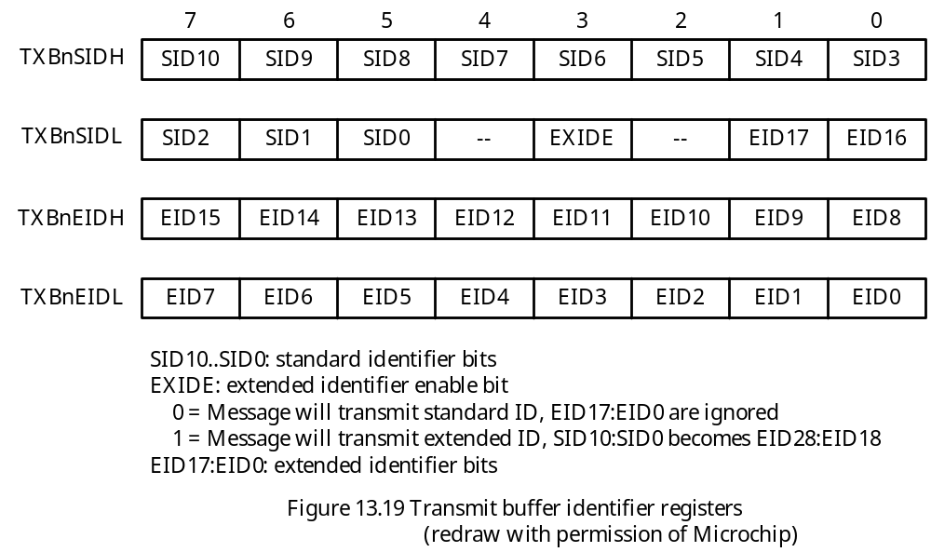
Transmit Identifier Registers
A can node uses the identifier contained in the message to arbitrate.
Four registers are provided to support both the standard and extended identifiers.

Slide 43
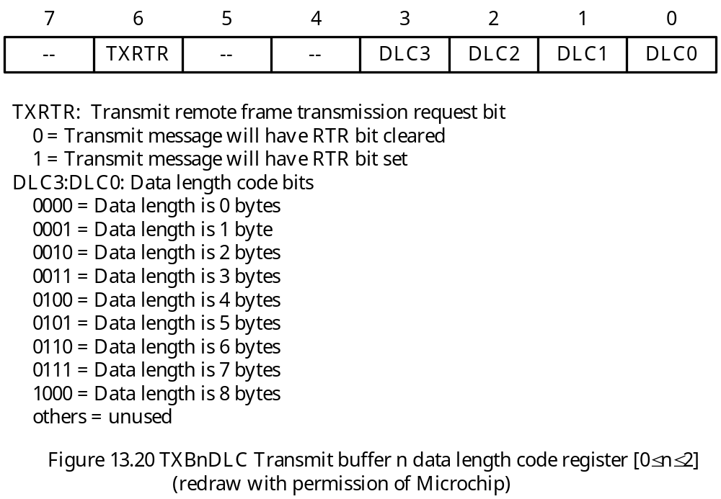
Transmit Buffer Data Length Count Register
Specifies the number of bytes of data in the transmit buffer.
This register also contains the remote transmit request bit.
The contents are shown in Figure 13.19.

Slide 44
Dedicated Receive Buffers
The CAN module has two dedicated receive buffers: RXB0 and RXB1.
Each buffer consists of 14 registers:
1. One receive control register (RXBnCON)
2. Four identifier registers (RXBnSIDL, RXBnSIDH, RXBnEIDL, and RXBnEIDH)
3. One data length count register (RXBnDLC)
4. Eight data registers (RXBnDm)
There is a separate message assembly buffer (MAB).
MAB is committed to receiving the next message from the bus and is not directly accessible to the user.
A message will be transferred to appropriate receive buffer if the corresponding acceptance filter criteria is met.
The contents of the RXBnCON register are shown in figure 13.21a and 13.21b.
The RXFUL bit must be cleared in software after the receive buffer is read.
No new message will be received if this bit is 1.
The lowest five bits (FILHIT4:FILHIT0) of the RXB0CON register tell the user which filter caused the message to be loaded into the dedicated received buffer (in mode 1 and 2).

Slide 45
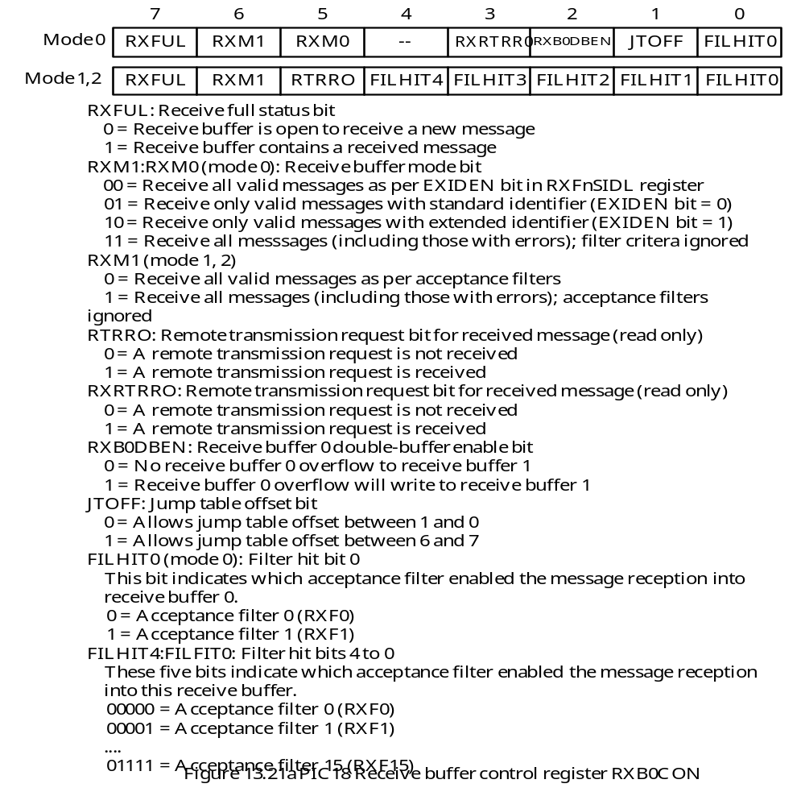

Slide 46
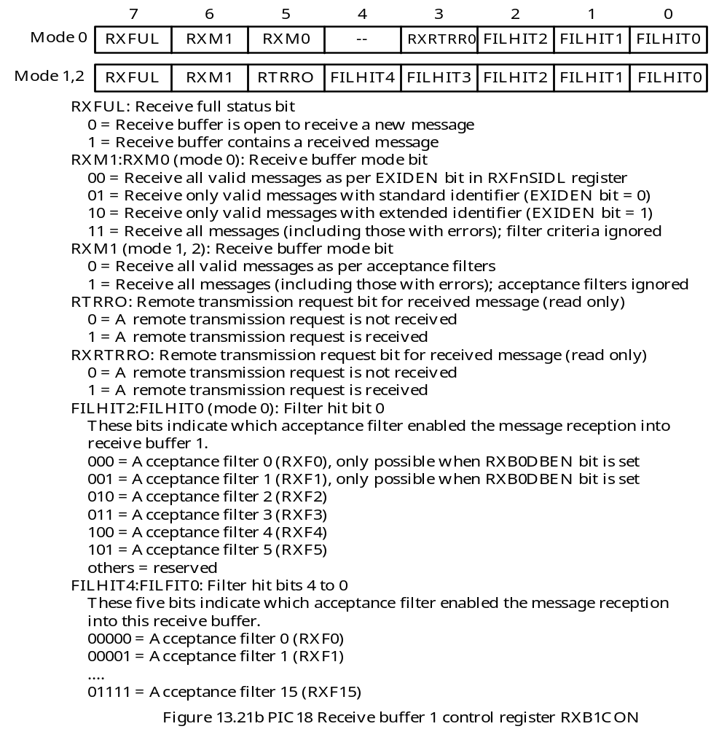

Slide 47
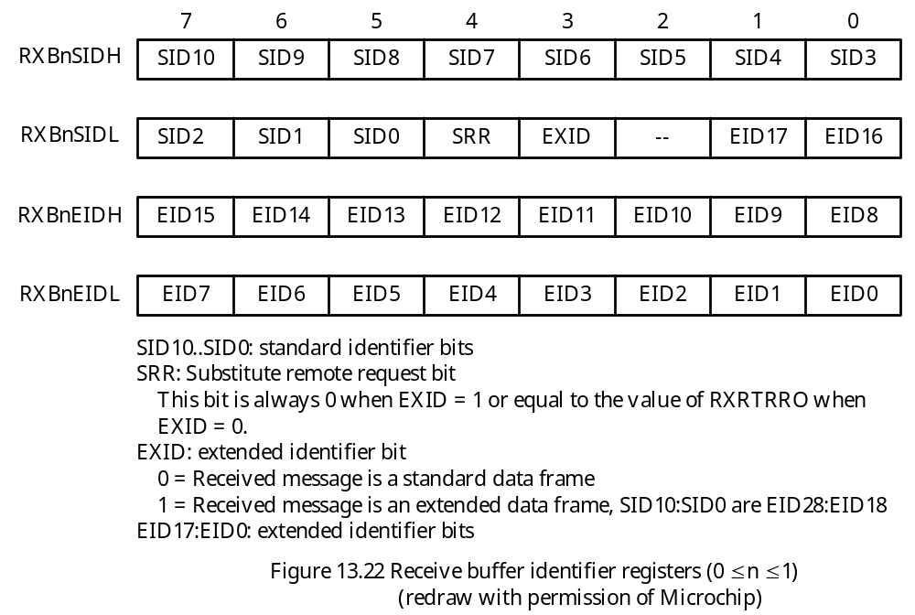
There are four receive identifier registers
Identifier registers store the identifier of the received message.

Slide 48
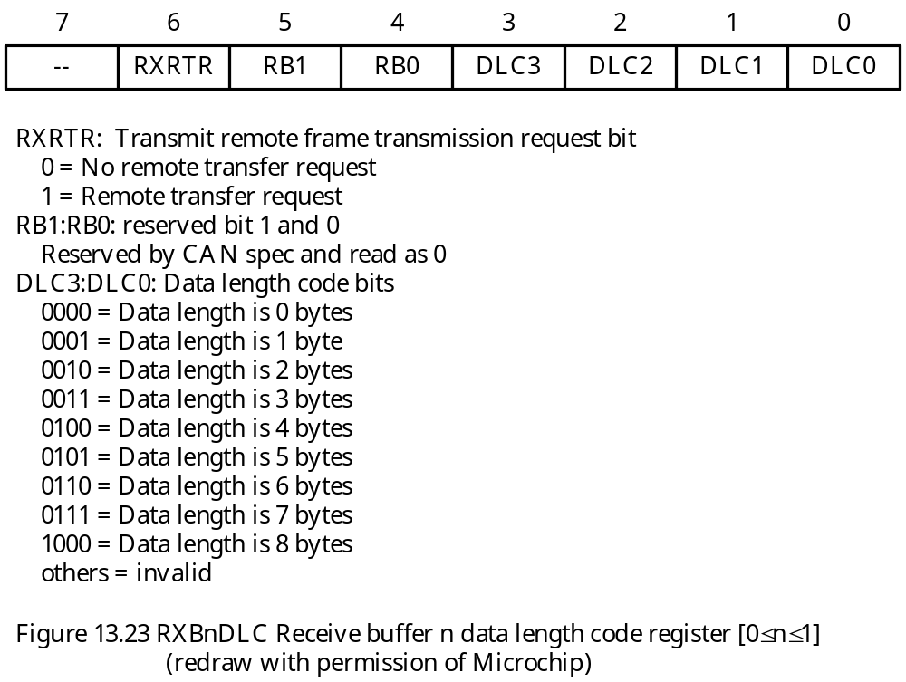
- Data length count register specifies the number of bytes contained in the received message and also indicates whether the message is a remote transmit request.

Slide 49
A skeleton of the receive routine:
rx_can btfss RXB0CON,RXFUL,A ; receive buffer RXB0 is in access bank
bra no_msg
btfss RXB0SIDL,EXID,A ; Is this extended identifier?
bra std_msg
; read all 29 bits of extended identifier
… ; process extended identifier
std_msg … ; process standard identifier
lfsr FSR0,can_rx_buf ; use FSR0 as a pointer to the buffer
lfsr FSR1,0xF66 ; point to RXB0D0
movf RXB0DLC,W,A ; save byte count in WREG
bz done ; no data to copy
cpy_loop movff POSTINC1,POSTINC0 ; copy one byte
decfsz WREG,W,A ; decrement the loop count
bra cpy_loop ; continue
bcf RXB0CON,RXFUL ; allow CAN to load new messages
done return

Slide 50
Programmable Transmit/Receive Buffers
Dedicated transmit buffers and receive buffers may not be adequate in some applications.
Programmable transmit and receive buffers are provided to remedy the problem.
These buffers are only available in mode 1 and mode 2.
The ECAN module implements 6 programmable transmit/receive buffers.
Each buffer contains one control register (BnCON), four identifier registers (BnSIDL, BnSIDH, BnEIDl, BnEIDH), one data length count register (BnDLC), and eight data byte registers BnDm.
Each of these registers contains two sets of control bits. One for transmission and the other for reception.
Each buffer can be programmed as a transmit buffer or a receive buffer by setting or clearing the TXENn bit in the BSEL0 register.
In mode 2, all receive buffers are combined to form a single FIFO.
Access to FIFO must be done through the FIFO pointer bits in the CANCON register.
The contents of the buffer control register (BnCON) are shown in Figure 13.24a and 13.24b.

Slide 51
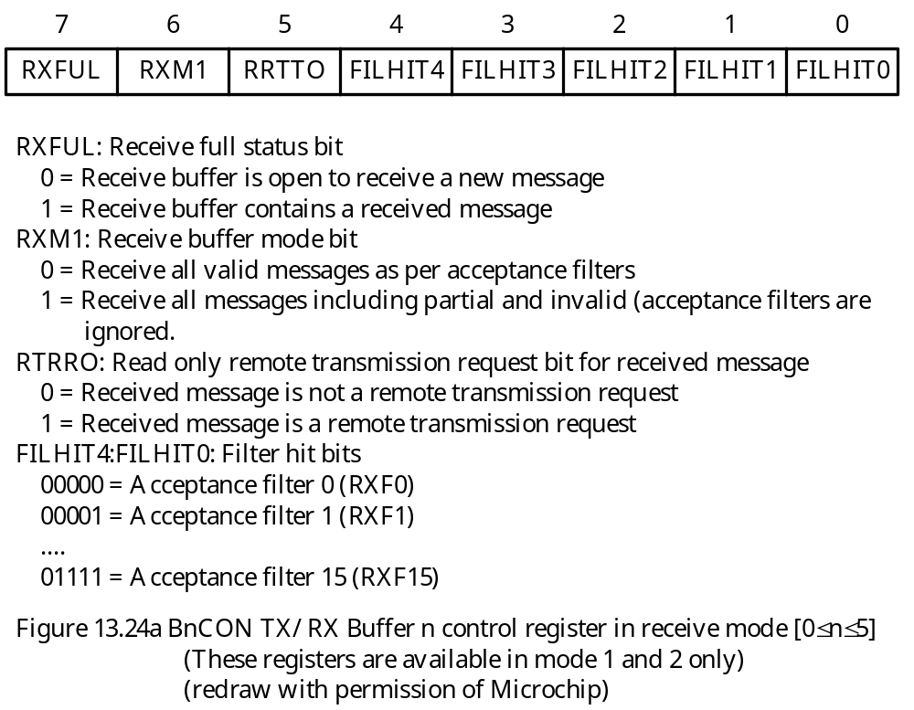

Slide 52
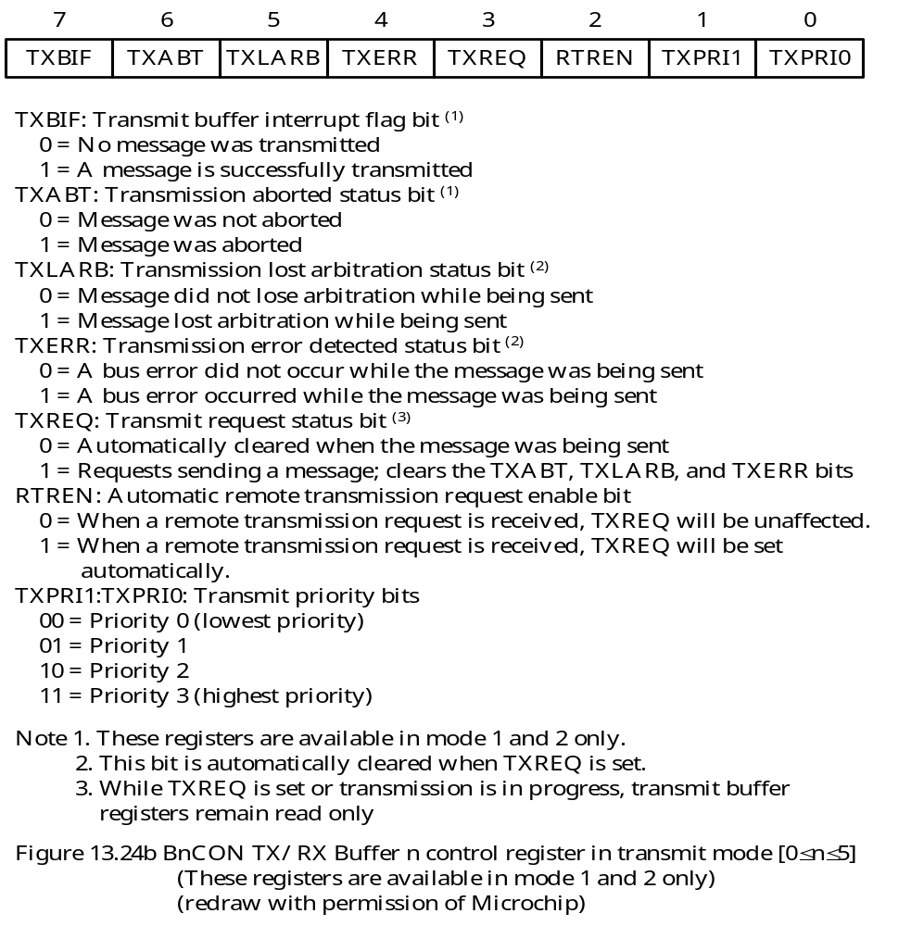

Slide 53
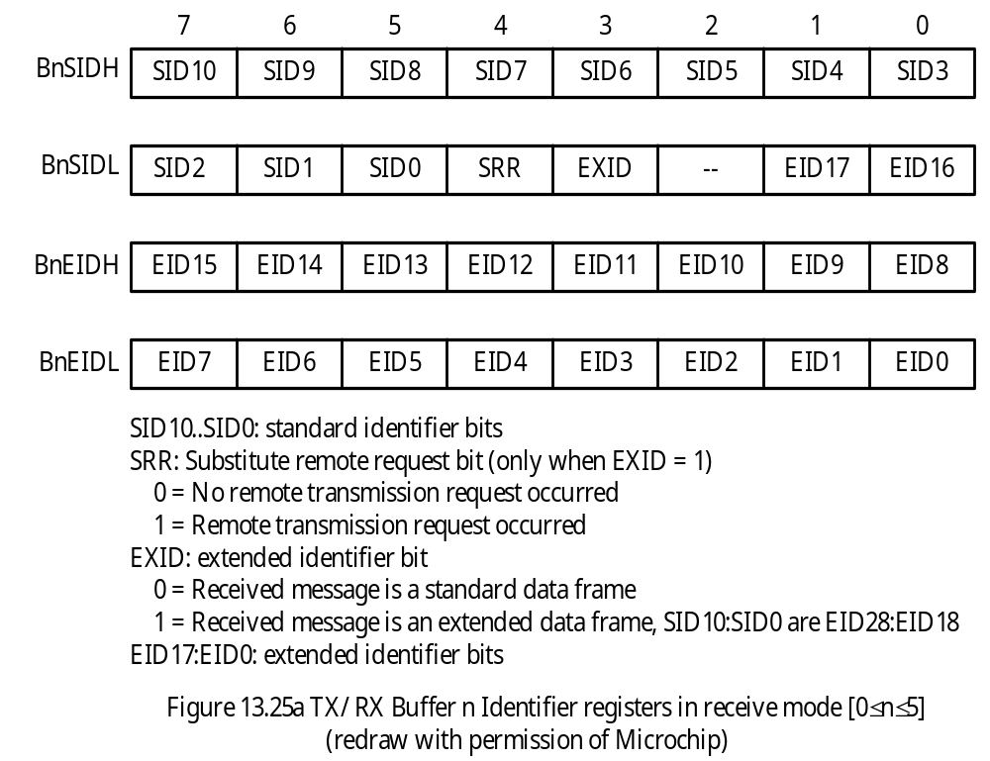
Identifier Registers of the Transmit/Receive Buffers

Slide 54
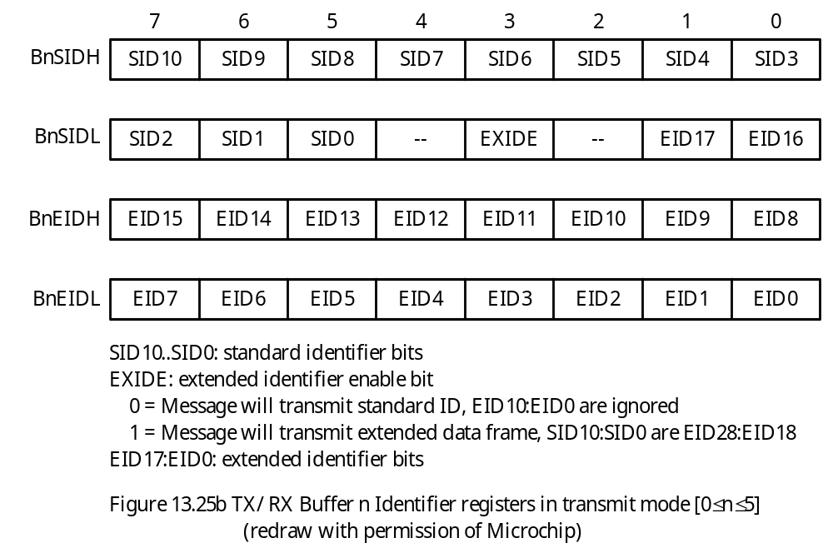

Slide 55
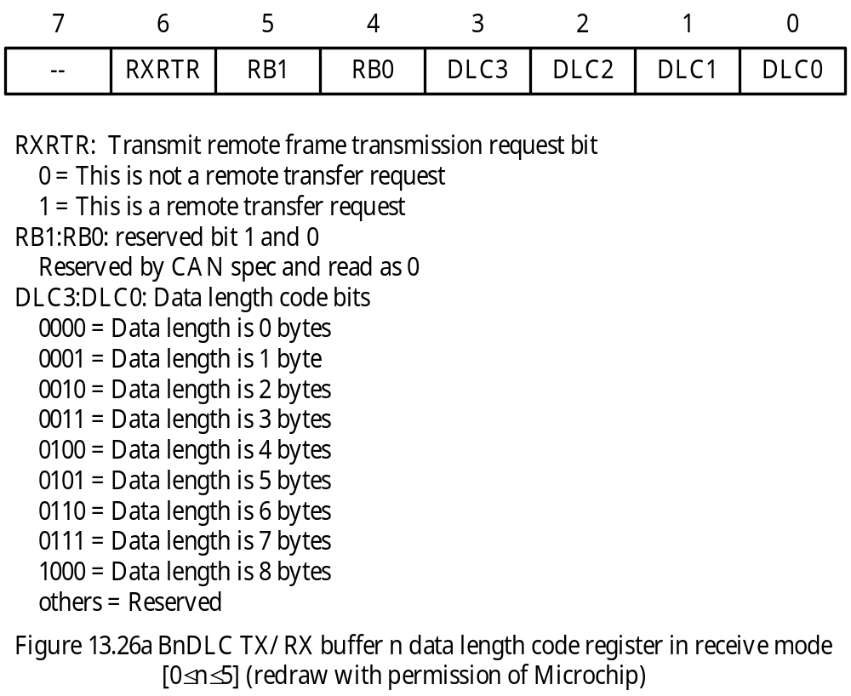
Data Length Count Register of Transmit/Receive Buffer

Slide 56
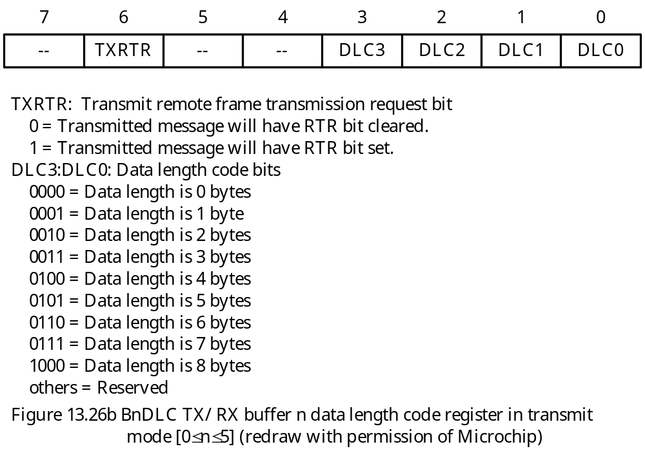

Slide 57
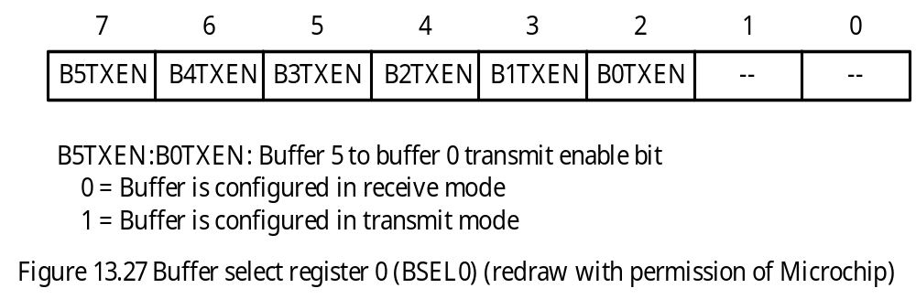
The user can configure each of the TX/RX buffers as a transmit buffer or a receive buffer by programming the BSEL0 register.

Slide 58
Programmable Auto RTR Buffers
In mode 1 and 2, any one of the TX/RX buffer can be programmed to automatically respond to predefined RTR messages without user’s intervention.
The procedure for setting up automatic RTR messages is as follows:
Step 1
Set buffer to transmit mode by setting the BnTXEN bit of the BSEL0 register to 1.
Step 2
Preload at least one associated acceptance filter register with the expected RTR identifier.
Step 3
Set the RTREN bit in the corresponding BnCON to 1.
Step 4
Preload the buffer with data to be sent as an RTR response.

Slide 59
Preparing Messages for CAN Transmission
Step 1
Load data into one of the transmit buffers (TXBnD0:TXBnD7 or BnD0:BnD7) when they are not busy (i.e., the associated TXREQ bit is clear).
Step 2
Set up the message identifier properly. This can be done by loading standard identifiers into the TXBnSIDH:TXBnSIDL (or BnSIDH: BnSIDL) or extended identifiers into TXBnEIDH:TXBnEIDL (or BnEIDH:BnEIDL).
Step 3
Set the TXREQ bit of the buffer to be transmitted. When the TXREQ bit is set, the TXABT, TXLARB, and TXERR bits will be cleared.
- When the transmission has completed successfully, the TXREQ bit will be cleared, the TXBnIF bit will be set.

Slide 60
Example 13.2 Write an instruction sequence to send out the string “T805H80” from transmit buffer 0. Use the standard identifier and set it to “0x100”.
Solution:
- The standard identifier is 0010 0000 000. The first 8 bits will be placed in TXB0SIDH register. The remaining 3 bits are placed in TXB0SIDL.
start movlw 'T' ; place the message in the transmit buffer
movff WREG,TXB0D0 ; “
movlw '8' ; “
movff WREG,TXB0D1 ; “
movlw '0' ; “
movff WREG,TXB0D2 ; “
movlw '5' ; “
movff WREG,TXB0D3 ; “
movlw 'H' ; “
movff WREG,TXB0D4 ; “
movlw '8' ; “
movff WREG,RXB0D5 ; “
movlw ‘0’ ; “
movff WREG,RXB0D6 ; “

Slide 61
; set up message identifier
; no need to load TXB0EIDL:TXB0EIDH
movlw 0x00
movff WREG,TXB0SIDL
movlw 0x20
movff WREG,TXB0SIDH
; set up data length code
movlw 0x07
movff WREG,TXB0DLC ; prepare to transmit 7 bytes
; mark the buffer for transmission, set to priority 0
movlw 0x08
movff WREG,TXB0CON
wait_tx movff TXB0CON,WREG
btfsc WREG,TXREQ
bra wait_tx

Slide 62
Aborting Transmission
A message transmission can be aborted by clearing the TXREQ bit associated with the corresponding message buffer.
The PIC18 can abort messages in all transmit buffers by setting the ABAT bit (in CANCON register).
If the message has not yet started transmission or has started but not successful, the abort request will be processed.
The abort of a message is indicated by the TXABT bit.
If a message has started transmission, the CAN module will attempt to complete the transmission.
Transmit Priority
A transmit buffer with the highest priority will be transmitted first.
If two buffers have the same priority setting, then the buffer with the highest buffer number will be sent first.

Slide 63
Message Reception
Once a message is loaded into receive buffer, user software can determine which filter caused this reception by checking the filter hit bits in the RXBnCON or the BnCON register.
In mode 0, the FILHIT<3:0> of the RXBnCON register are the filter hit bits.
In mode 1 and mode 2, the FILHIT<4:0> bits of the BnCON register are the filter hit bits.
A receive message is considered a standard message if the EXID bit of the RXBnSIDL or the BnSIDL register is 0. Otherwise, it is an extended message.
Receive Modes
CAN module has four receive modes.
A receive buffer can be configured to receive only standard messages, to receive only extended messages, to receive valid messages as per the EXIDE bit, or receive all messages up to the error point.

Slide 64
Enhanced FIFO Mode
- There is no direct correlation between filters and receive buffer registers.
Any filter that has been enabled can generate an acceptance.
The entire FIFO contains contiguous buffers.
When a message is received in the FIFO mode, the interrupt flag code bits (EICODE<4:0>) in the CANSTAT register will have a value of 10000, indicating that the FIFO has received a message.
FIFO pointer bits FP<3:0> in the CANCON register point to the buffer that contain a data not yet read.
To determine whether FIFO is empty, the user may use FP<3:0> bits to access the RXFUL bit in the current buffer.
In mode 2, the module also provides a bit called FIFO high water mark (FIFOWM) in the ECANCON register.

Slide 65
Time Stamping
The arrival time of the message may be critical in some application.
The CAN module can be programmed to generate a time-stamp for every message that is received.
When enabled, the module generates a capture signal for CCP1, which in turn captures the value of either Timer 1 or Timer 3.
To use the time-stamp capability, the CANCAP bit (bit 4 of the CIOCAN register) must be set. In addition, CCP1CON<3:0> must be set to 0011 to enable the CCP special event trigger for CAN events.
The following instruction sequence will perform the desired setting for CAN message time stamping:
bsf CIOCAN,CANCAP ; enable CAN message arrival time capture
movf CCP1CON,W ; set the lowest 4 bits of CCP1CON to
andlw 0xF3 ; 0011
iorlw 0x03 ; “
movwf CCP1CON ; “

Slide 66
Message Acceptance Filters and Masks
Acceptance filters and masks are used to determine if a message should be accepted.
When a mask bit is set to 1, the corresponding bits in the message identifier and the filter will be compared.
Only the matched identifiers will be accepted.
In mode 0, there are six filters and two masks. RXF0 and RXF1 are associated with RXB0 whereas RXF2 through RXF5 are associated with RXB1.
In mode 1 and 2, there are 10 additional filters (RXF6 through RXF15).
The filter RXF15 can be used either as an acceptance filter or an acceptance mask.
Each of these filters can be enabled/disabled individually through the RXFCON0 and RXFCON1 registers.
The association of a filter with the receive buffer is done through the RXFBCON0 through RXFBCON7 registers. Each filter uses 4 bits to do the association.

Slide 67
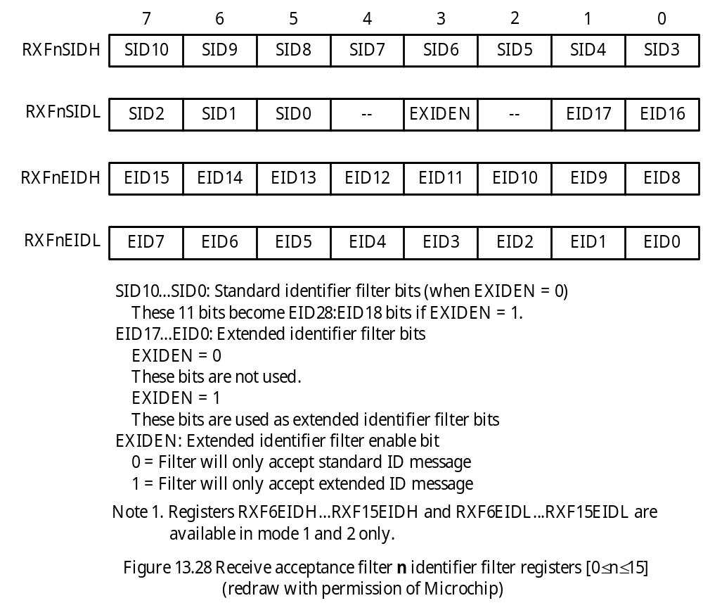

Slide 68
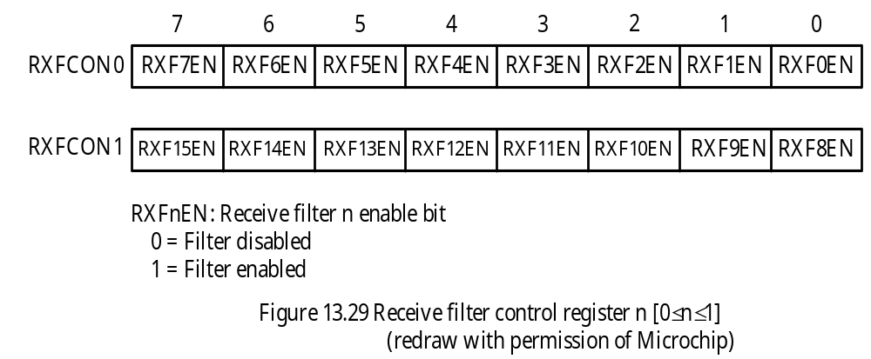

Slide 69
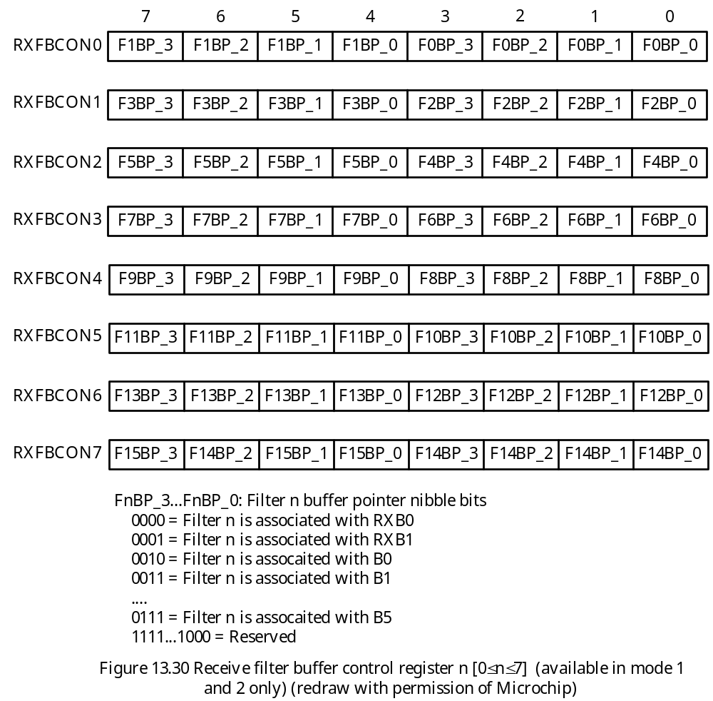

Slide 70
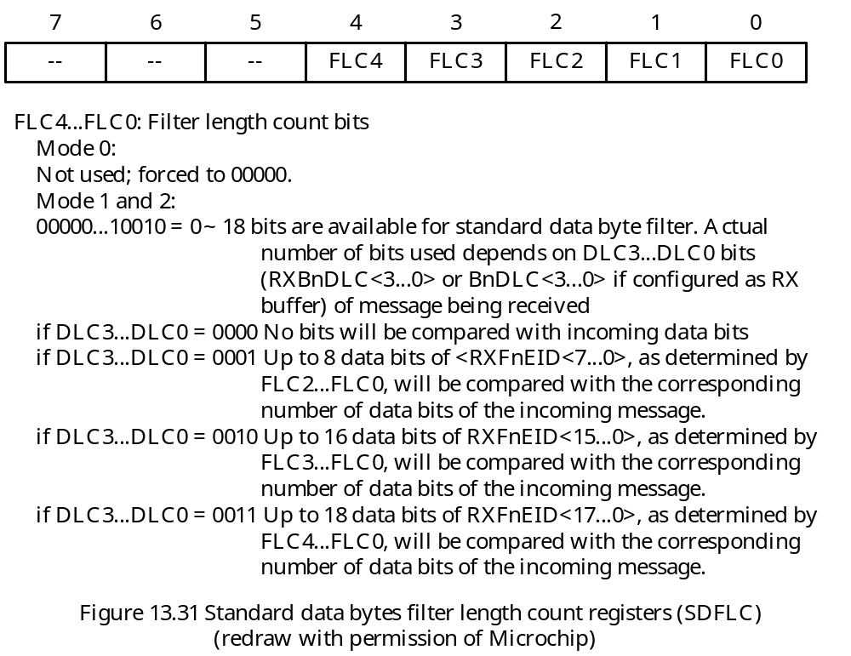
Filter Length Count Register
- Select the number of bits in the filter to be compared for reception.

Slide 71
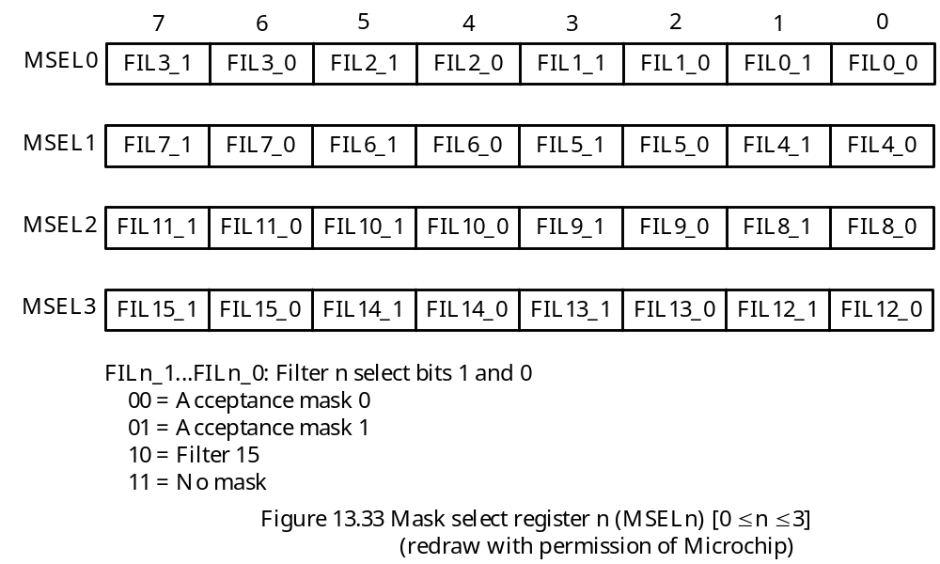
Association Reception Filter with Mask
One can dynamically associated a filter with any mask.
The association of a filter with a mask is done by programming the MSELn register.
The contents of the MSELn register are shown in Figure 13.33.

Slide 72
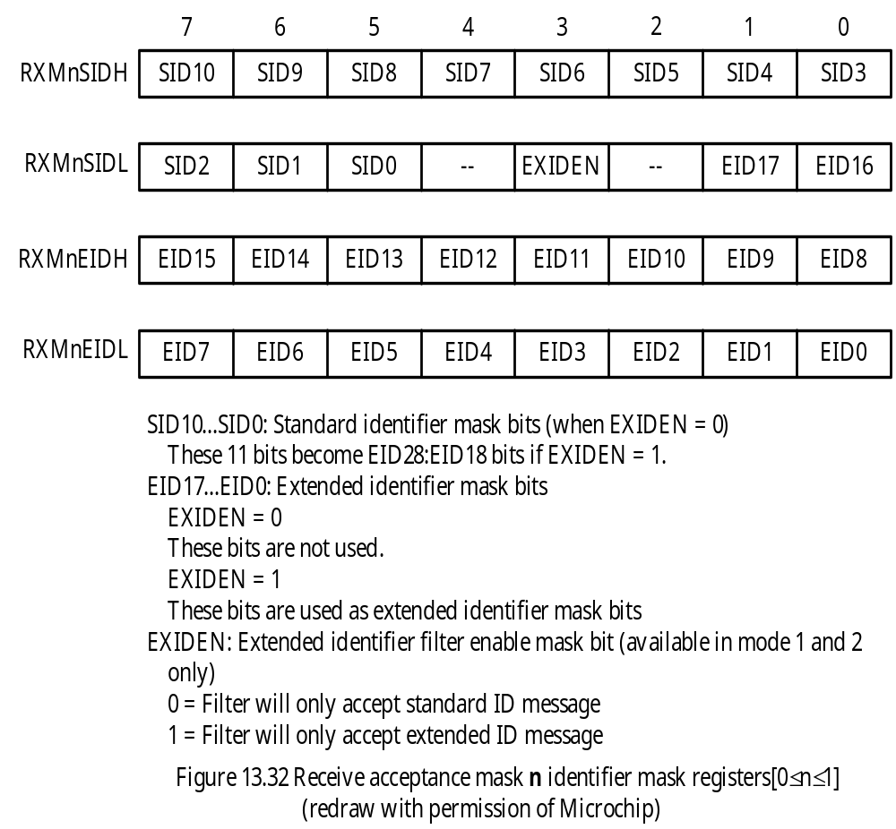
The Acceptance Mask Register

Slide 73
Instruction Sequence to Associate a Mask with a Filter
movlw 0
movff WREG,MSEL0 ; associates filters 0 to 7 with mask 0
movff WREG,MSEL1 ; “
movlw 0x55 ; associates filters 8 to 15 with mask 1
movff WREG,MSEL2 ; “
movff WREG,MSEL3 ; “
In C language,
MSEL0 = MSEL1 = 0;
MSEL2 = MSEL3 = 0x55;

Slide 74
Baud Rate Setting and Timing Parameters
A nominal bit time is divided into four segments.
1. Synchronization segment (sync_seg)
2. Propagation time segment (prop_seg)
3. Phase buffer segment 1 (phase_seg1)
4. Phase buffer segment 2 (phase_seg2)
These time segments are in turn made up of integer units of time quanta (TQ).
The nominal bit time can be written as follows:
T_{BIT} = TQ × (sync_seg + prop_seg + phase_seg1 + phase_seg2) (13.1)
TQ is derived from the oscillator period as follows:
TQ = 2 × (BRP + 1) × T_{OSC} (13.2)
where, BRP is an integer from 0 to 63
The BRP bits are contained in the BRGCON1 register.
BRGCON2 and BRGCON3 define other timing parameters.

Slide 75
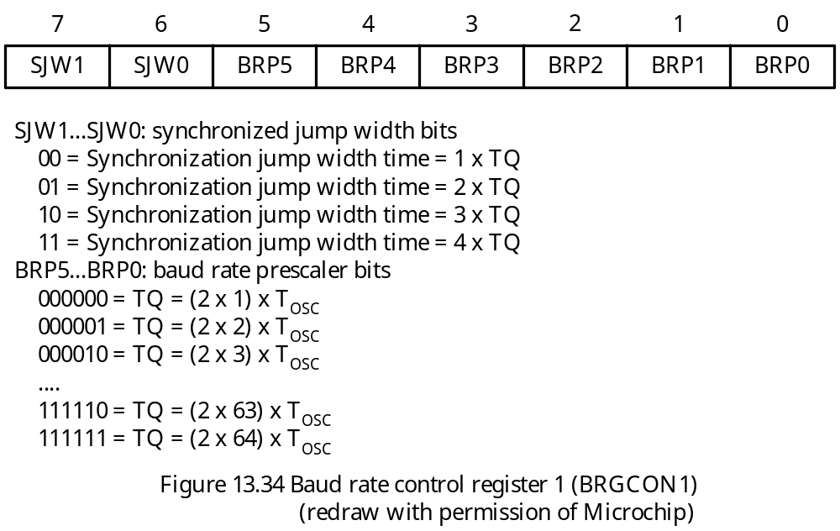

Slide 76
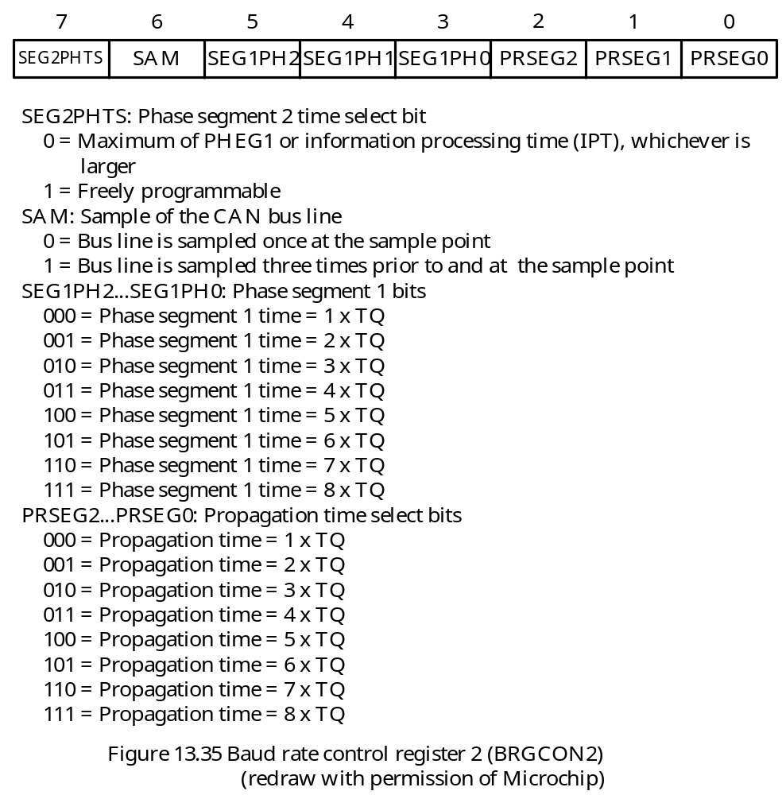

Slide 77
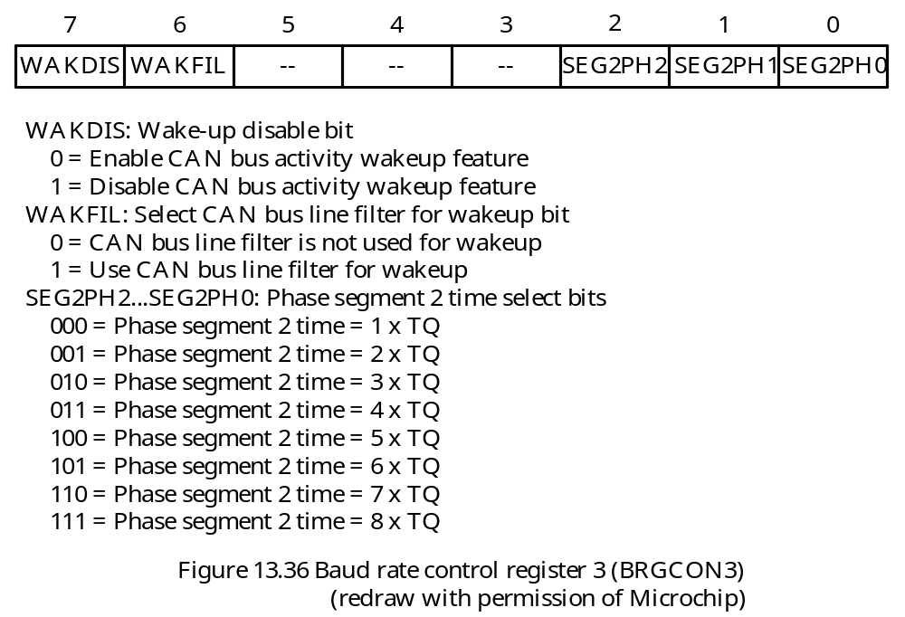

Slide 78
Error Detection and Interrupts
The CAN module detects all errors required by the CAN protocol.
CAN Interrupts
The PIR3 register holds all the CAN interrupt flag bits.
The PIE3 holds all the CAN interrupt enable bits.
The priority of the CAN interrupts can be set via the IPR3 register.
The contents of these three registers are shown in Figure 13.38, 13.39, and 13.40, respectively.
Each dedicated transmit buffer and receive buffer and programmable TX/RX buffer has its own interrupt enable bit as shown in Figure 13.41 and 13.42.
For mode 1 and mode 2, the TXBnIE bit (bit 4) enables all transmit buffer interrupts and the RXBnIE bit enables all receive buffer interrupts.
For mode 1 and mode 2, all transmit buffers share one interrupt flag (TXBnIF) and one interrupt priority bit (TXBnIP).
For mode 1 and mode 2, all receive buffers share one interrupt flag (RXBnIF) and one interrupt priority bit (RXBnIP).

Slide 79
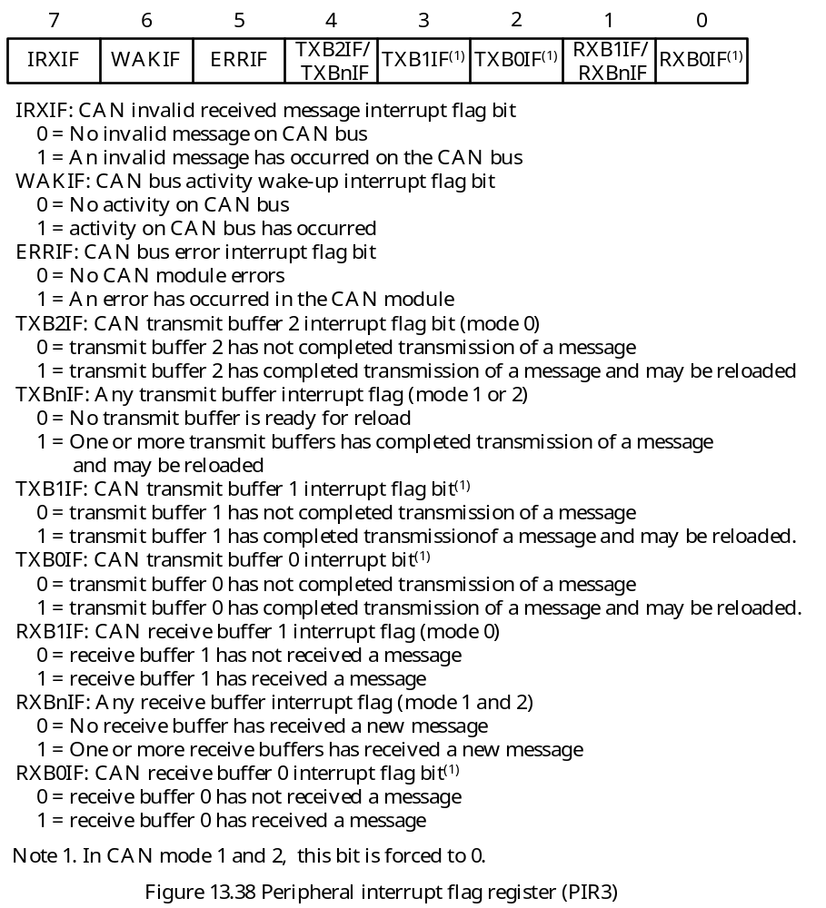

Slide 80
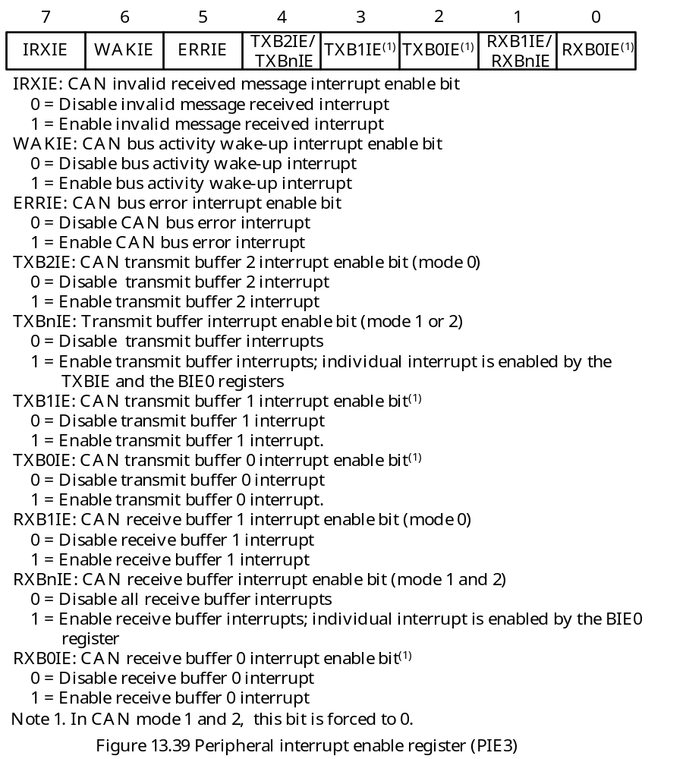

Slide 81
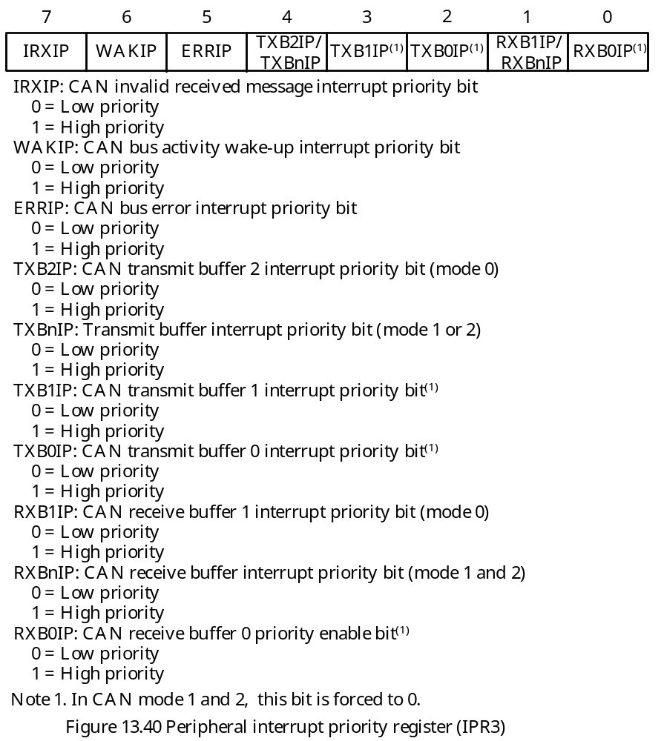

Slide 82
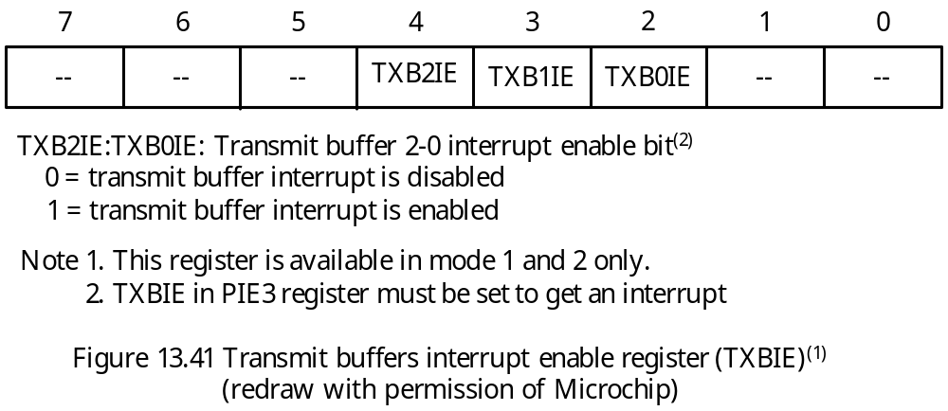
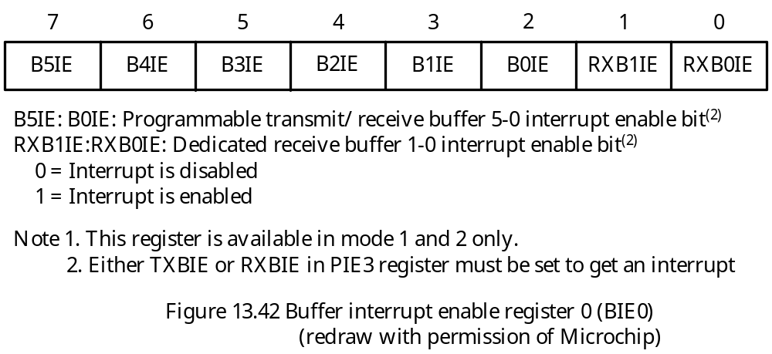

Slide 83
Efficient Handling of CAN Interrupts
CAN interrupts are internally prioritized and lower values are assigned to higher priority interrupts.
Once the highest priority interrupt condition has been cleared, the code for the next highest priority interrupt that is pending will be reflected by the ICODE (mode 0) or EICODE (mode 1 and 2).
Only those interrupt sources that have their associated interrupt enable bit set will be reflected in the ICODE (or EICODE).
Transmit Interrupt
In mode 0, there are separate interrupt enable/disable and flag bits for each of the three transmit buffers.
An interrupt will be generated when the associated transmit buffer becomes empty and is ready to be loaded with a new message.
In mode 1 and mode 2, all transmit interrupts share one enable bit and one flag bit. As long as one transmit buffer becomes empty, the TXBnIF flag bit will be set.
Individual transmit buffer interrupts can be enabled/disabled using the TXBIE and BIE0 registers.
When an transmit buffer interrupt occurs, user software must check the TXBIF bit of all transmit buffer control registers to detect the source of interrupt.

Slide 84
Receive Interrupt
When enabled, a receive interrupt will be generated when a message has been successfully received and loaded into the associated receive buffer.
In mode 0, the RXB0IF (or RXB1IF) bit is set to indicate the source of the interrupt. This flag must be cleared by the user software.
In mode 1 and 2, all receive buffers share RXBIE, RXBIF, and RXBIP in PIE3, PIR3, and IPR3, respectively.
Individual receive buffer interrupts can be controlled by the TXBIE and BIE0 registers.
In mode 1, when a shared receive interrupt occurs, user software must poll the RXFUL bit of each receive buffer to detect the source of interrupt.
In mode 2, a receive interrupt indicates that the new message is loaded into the FIFO. The FIFO can be read by using the FIFO pointer bits, FP.
Message Error Interrupt
When an error occurs during the transmission or reception of a message, the message error flag, IRXIF, will be set.
An interrupt will be generated if the IRXIE bit is set.
This is intended to be used in facilitating baud rate determination when used in conjunction with the listen-only mode.

Slide 85
Bus Activity Wake-Up Interrupt
When the PIC18 device is in sleep mode and the bus activity wake-up interrupt is enabled, an interrupt will be generated and the WAKIF bit will be set when activity is detected on the CAN bus.
This interrupt causes the PIC18 devices to exit sleep mode.
Error Interrupt
An interrupt may be generated if an overflow occurs or if the error state of the transmitter or receiver has changed.
The error flags in the COMSTAT register indicates one of the error conditions:
1. Receiver overflow: This will occur when MAB has received a message but the receive buffer associated with the filter is not available.
2. Receiver warning: receiver error counter has reached the warning point 96.
3. Transmitter warning: transmitter error counter has reached the warning point 96.
4. Receiver bus passive: receiver error count has exceeded 127.
5. Transmitter bus passive: transmitter error count has exceeded 127.
6. Bus off: transmitter error counter has exceeded 255

Slide 86
CAN Module I/O Control Register
The voltage level for the CANTX2 pin and the CCP capture control can be programmed by configuring the CIOCON register.
The CANCAP bit allows the user to capture the timer1 value into CCP1 register when a receive message arrived.
This provides the time-stamp to the message just received.

Slide 87
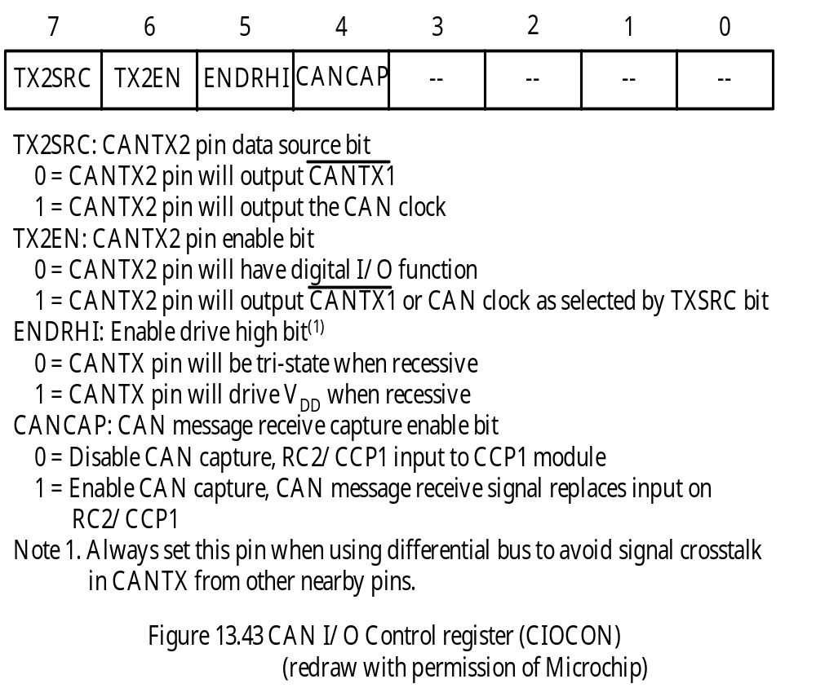

Slide 88
Physical CAN BUS Connection
A typical CAN bus system is shown in Figure 13.13.
Both ends of the CAN bus must be terminated by a resistor with a resistance of about 120 Ω.
A CAN bus transceiver is needed to provide the current capability required by the CAN bus.
The CAN bus transceiver is connected to the CAN bus via two bus terminators, CAN_H and CAN_L, which provide differential receive and transmit capabilities.
The nominal CAN bus levels are shown in Figure 13.44.
There are many CAN bus transceivers: Microchip MCP2551, Philips PCA82C250/251, TI SN65HVD251, and MAXIM MAX3050/3057 are the most popular ones.

Slide 89
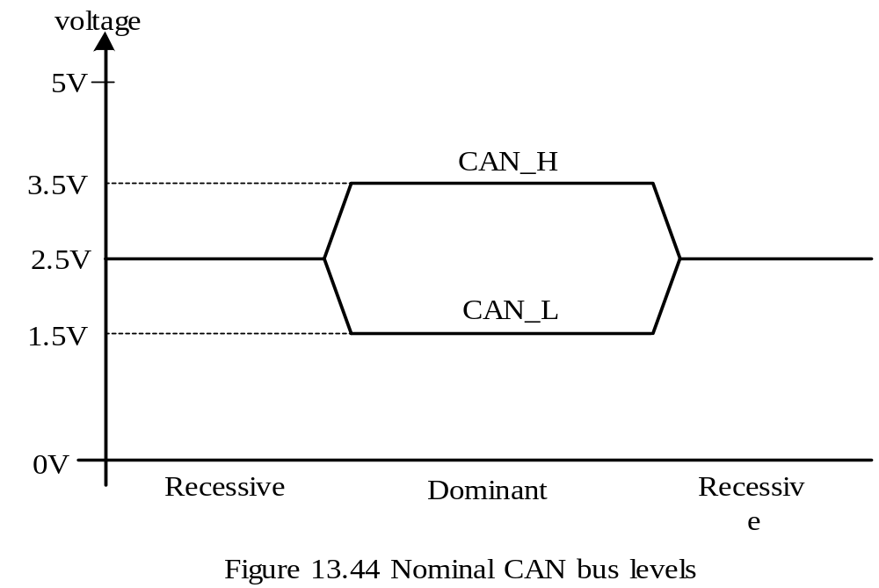

Slide 90
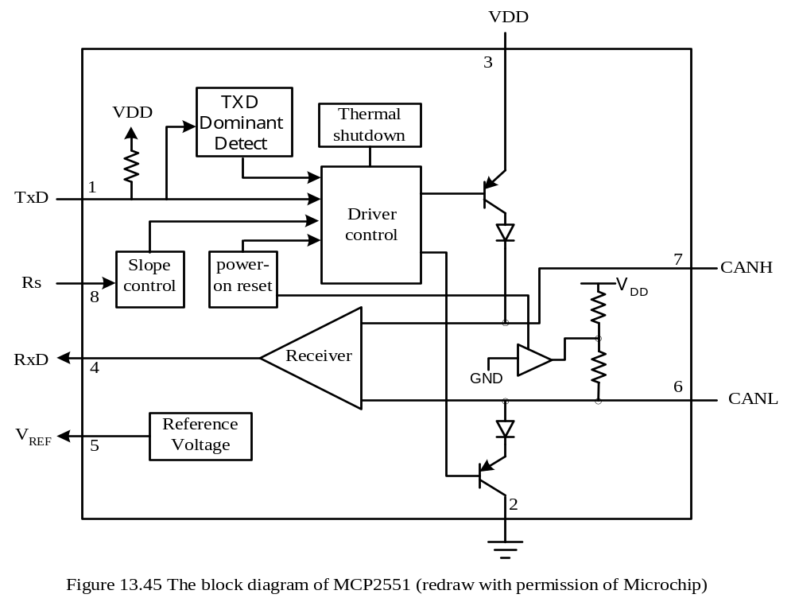
The MCP2551 CAN Transceiver

Slide 91
Features of the MCP2551
Converts the digital signals generated by a CAN controller to signals suitable for transmission over the bus cabling.
Provides a buffer between the CAN controller and the high-voltage spikes that can be generated on the CAN bus by outside sources.
Operates at speeds up to 1 Mbps.
Up to 112 nodes can be connected to the CAN bus using the MCP2551s.
The RxD pin reflects the differential bus voltage between CAN_H and CAN_L.
The Rs input allows the user to select one of the three operation modes:
1. High-speed
2. Slope-control
3. Standby
The slew rate is controlled by the resistor connected to the Rs pin (shown in Figure 13.46).
High-speed mode is selected by grounding the Rs pin.
Standby mode is entered by connecting the Rs pin to V_{DD}.
A table of CAN bus bit rate vs. bus length is in Table 13.2

Slide 92
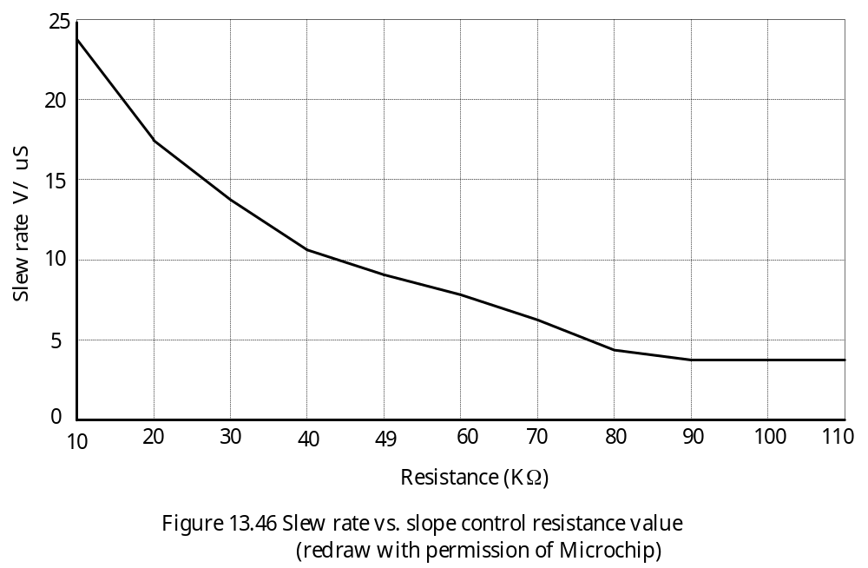

Slide 93
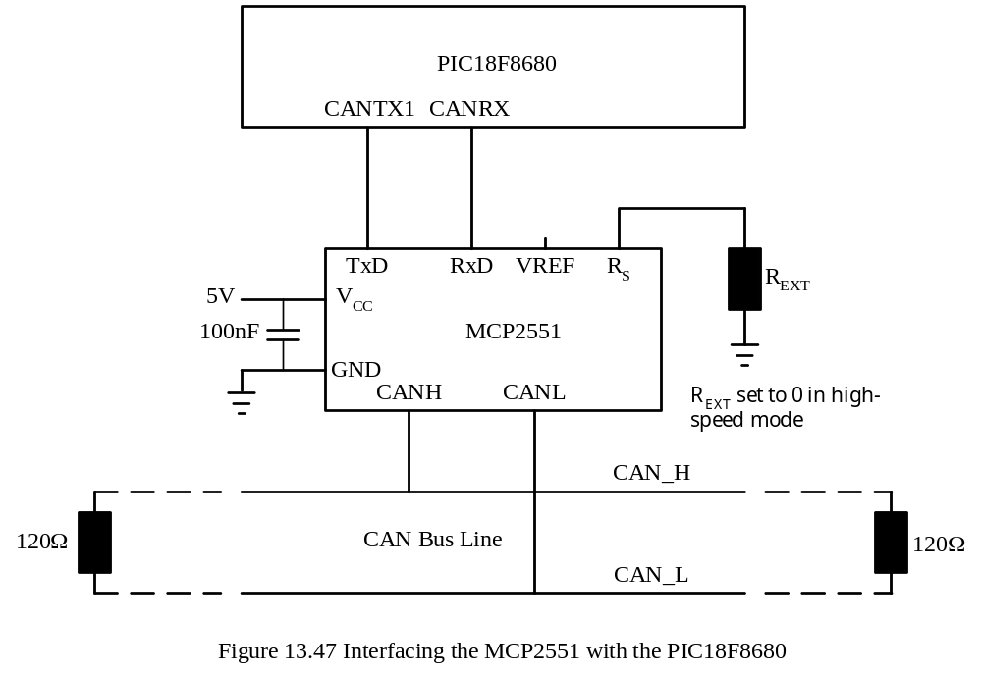
Interfacing the MCP2551 to the PIC18F CAN Devices
Typical circuit connection is shown in Figure 13.47.

Slide 94
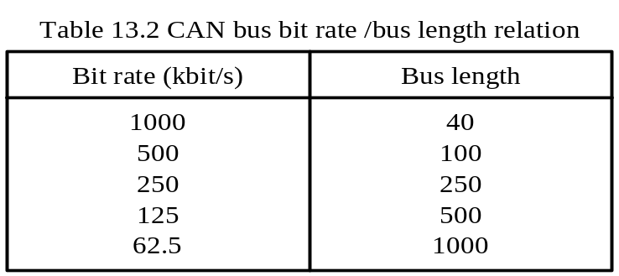
Setting the CAN Timing Parameters
Let t_{BUS}, t_{TX}, and t_{RX} represent the data traveling time on the bus, transmitter propagation delay, and receiver propagation delay, respectively.
The worst-case value for t_{PROP_SEG} is
t_{PROP_SEG} = 2 × (t_{BUS} + t_{TX} + t_{RX}) (13.5)
In units of time quantum,
prop_seg = round_up (t_{PROP_SEG} ÷ t_{Q}) (13.6)

Slide 95
- In the absence of bus errors, bit stuffing guarantees a maximum 10-bit period between resynchronization edges.
The accumulated phase errors is due to the tolerance in the CAN system clock, this requirement can be expressed as
(2 × Δf) × 10 × t_{NBT} < t_{RJW} (13.7)
where, Δf is the largest crystal oscillator frequency variation.
When bus error exists, An error flag from an error active node consists of six dominant bits, and there could be up to six dominant bits before the error flag, if, for example, the error was a stuff error.
A node must therefore correctly sample the 13th bit after the last resynchronization. This can be expressed as
(2 × Δf) × (13 × t_{NBT} – t_{PHASE_SEG2}) < min (t_{PHASE_SEG1}, t_{PHASE_SEG2}) (13.8)

Slide 96
Procedure for determining the optimum bit timing parameters:
Step 1
Determine the minimum permissible time for the prop_seg segment using equation 13.5.
Step 2
Choose the CAN system clock frequency. The CAN system clock frequency will be half of the CPU oscillator output frequency divided by a prescale factor. The chosen clock frequency must make the t_{NBT} a integral multiple of t_{Q} from 8 to 25.
Step 3
Calculate the prop_seg duration using equation 13.6. If the resultant value is greater than 8, go back to Step 2 and choose a lower CAN system clock frequency.
Step 4
Determine phase1_seg and phase_seg2. Subtract the prop_seg value and one from the time quanta contained in a bit time. If the difference is less than three than go back to Step 2 and select a higher CAN system clock frequency. If the difference is 3, then phase_seg1 = 1 and phase_seg2 = 2 and only one sample per bit may be chosen. Otherwise divide the remaining number by two and assign the result to phase_seg1 and phase_seg2.

Slide 97
Step 5
Determine the resynchronization jump width (RJW). RJW is the smaller one of four and phase_seg1.
Step 6
Calculate the required oscillator tolerance from equation 13.7 and 13.8. If phase_seg1 > 4, it is recommended that you repeat Steps 2 to 6 with a larger value for the prescaler.
Example 13.3 Calculate the CAN bit segments for the following constraints:
Bit rate = 800 Kbps
Bus length = 25 m
Bus propagation delay = 5 × 10⁻⁹ sec/m
CAN transceiver plus receiver propagation delay = 150 ns at 85ºC
CPU oscillator frequency = 32 MHz
Solution:
Step 1
Physical delay of the CAN bus = 25 × 5 = 125 ns
t_{PROP_SEG} = 2 × (125 + 150) = 550 ns

Slide 98
Step 2
The minimum time quantum 2 ÷ (32 MHz /2) = 125 ns (set prescaler to 2).
One bit time is 1/800 Kbps = 1250 ns.
One bit time (NBT) corresponds to 10 (= 1250 ns ÷ 125) time quanta.
Step 3
Prop_seg = round_up (550 ns ÷ 125) = 5.
Step 4
NBT – prop_seg1 – sync_seg = 10 – 5 – 1 = 4.
phase_seg1 = 4/2 = 2,
phase_seg2 = 4 – phase_seg1 = 2
Step 5
RJW = min (4, phase_seg1) = 2
Step 6
From equation 13.7,
Δf < RJW ÷ (20 × NBT) = 2 ÷ (20 × 10) = 1%
From equation 13.8,
Δf < min(phase_seg1, phase_seg2) ÷ [2 × (13 × NBT – phase_seg2)]
= 2 ÷ 256 = 0.78%
The desired oscillator tolerance is 0.78%.

Slide 99
Most crystal oscillators have tolerance smaller than 0.78%.
In summary,
Prescaler = 2
Nominal bit time = 10 (1.25μs ÷ 125 ns)
prop_seg = 5
sync_seg = 1
phase_seg1 = 2
phase_seg2 = 2
RJW = 2
oscillator tolerance = 0.78%

Slide 100
Example 13.4 Calculate the CAN bit segments for the following constraints:
Bit rate = 500 Kbps
Bus length = 70 m
Bus propagation delay = 5 × 10⁻⁹ sec/m
CAN transceiver plus receiver propagation delay = 150 ns at 85ºC
CPU oscillator frequency = 40 MHz
Solution:
Step 1
Physical delay of the bus = 70 × 5 × 10⁻⁹ sec/m = 350 ns
t_{PROP_SEG} = 2 × (350 + 150) = 1000 ns
Step 2
Try 2 as the prescaler.
The resultant T_{Q} is 100 ns.
Quanta per bit = 2,000 /100 = 20
Step 3
Prop_seg = round_up (1000 ÷ 100) = 10 > 8.
Reset the prescaler to 4.
The resultant new time quantum is 200 ns.
One bit time correspond to 10 time quanta.
The new prop_seg = round_up (1000 ÷ 200) = 5.

Slide 101
Step 4
NBT – prop_seg –sync_seg = 10 – 5 – 1 = 4
phase_seg1 = 4/2 = 2
phase_seg2 = 4 – phase_seg1 = 2
Step 5
RJW = min (4, phase_seg1) = 2
Step 6
From equation 13.7,
Δf < RJW ÷ (20 × NBT) = 2 ÷ (20 × 10) = 1.0%
From equation 13.8,
Δf < min(phase_seg1, phase_seg2) ÷ [2 × (13 × NBT – phase_seg2)]
= 2 ÷ 256 = 0.78%
In summary,
Prescaler = 4
Nominal bit time = 10 (2μs ÷ 200 ns)
Prop_seg = 5
Sync_seg = 1
Phase_seg1 = 2
Phase_seg2 = 2
RJW = 2
Oscillator tolerance = 0.78%

Slide 102
CAN Programming
Only a small subset of CAN-related registers is in the access bank.
In assembly language, one can use the banksel directive to generate the appropriate instruction to switch the active bank to simplify the access of the registers.
Another method is to use the movff instruction to access any CAN-related registers. This is the approach used in this book.
Example 13.5 Write a program to configure the CAN module with the timing parameters in Example 13.3, disable all interrupts, and set the ECAN module to receive all messages with standard identifiers.
Solution: One need to switch into the configuration mode before any setting can be made.
#include <p18F8680.inc>
org 0x00
goto start
org 0x08
retfie
org 0x18
retfie

Slide 103
start movlw 0x80
movwf CANCON,A ; set to configuration mode
conf_wait movf CANSTAT,W,A ; read current mode state
andlw 0x80
bz conf_wait ; if not configuration mode, branch
clrf ECANCON,F,A ; select mode 0
movlw 0x41 ; set RJW to 2, prescaler set to 2
movwf BRGCON1,A ; "
movlw 0x89 ; take one sample, set phase_seg1 to 2 and
movwf BRGCON2,A ; set prop_seg to 5
movlw 0x41 ; enable wakeup feature, set phase_seg2 to
movwf BRGCON3,A ; 2
movlw 0x20 ; RXB0 and RXB1 receive any standard message
movff WREG,RXB0CON ; "
movff WREG,RXB1CON ; "
movlw 0 ; clear receive mask registers
movff WREG,RXM0SIDH ; to receive all standard messages
movff WREG,RXM0SIDL ; "
movff WREG,RXM1SIDH ; "
movff WREG,RXM1SIDL ; "
clrf CANCON,A ; set to normal mode
conf_w1 movf CANSTAT,W,A ; read current mode state
bz conf_w1 ; if not normal mode, branch
end

Slide 104
In C language,
#include <p18F8680.h>
void main (void)
{
CANCON = 0x80; /* set to configuration mode */
while(!(CANSTAT & 0x80)); /* wait until configuration mode is entered */
ECANCON = 0x00; /* select mode 0 */
BRGCON1 = 0x41; /* set RJW to 2, prescaler set to 2 */
BRGCON2 = 0x8C; /* take one sample, set phase_seg1 to 2 and
set prop_seg to 5 */
BRGCON3 = 0x41; /* enable wakeup feature, set phase_seg2 to 2 */
RXB0CON = 0x20; /* RXB0 receive any standard message */
RXB1CON = 0x20; /* RXB1 receive any standard message */
RXM0SIDH = 0; /* clear receive mask registers to receive all */
RXM0SIDL = 0; /* standard format messages */
RXM1SIDH = 0;
RXM1SIDL = 0;
CANCON = 0; /* set to normal mode */
while(CANSTAT & 0xE0); /* wait until normal mode is entered */
}

Slide 105
Example 13.6 Write a program to configure the CAN module with the timing parameters computed in Example 13.4, disable all interrupts, and set the ECAN module to receive all extended messages started with extended identifier “SH”. Use mode 0 and receive buffer 0 to receive the message.
Solution:
#include <p18F8680.inc>
org 0x00
goto start
org 0x08
retfie
org 0x18
retfie
start movlw 0x80
movwf CANCON,A ; set to configuration mode
conf_wait movf CANSTAT,W,A ; read current mode state
andlw 0x80
bz conf_wait ; if not configuration mode, branch
clrf ECANCON,A ; select mode 0
movlw 0x43 ; set RJW to 2, prescaler set to 4
movwf BRGCON1,A ; “
movlw 0x8C ; take one sample, set phase_seg1 to 2 and

Slide 106
movwf BRGCON2,A ; set prop_seg to 5
movlw 0x41 ; enable wakeup feature, set phase_seg2 to
movwf BRGCON3,A ; 2
movlw 0x53 ; load "SH" into receive acceptance filter
movff WREG,RXF0SIDH,A ; registers
movlw 0x49 ; "
movff WREG,RXF0SIDL,A ; "
movlw 0x20 ; “
movff WREG,RXF0EIDH ; “
movlw 0x00
movff WREG,RXF0EIDL ; "
movlw 0xFF
movff WREG,RXM0SIDH ; set up receive mask registers to receive all
movlw 0xEB ; extended messages with identifiers starting
movff WREG,RXM0SIDL ; with "SH"
movlw 0xE0 ; "
movff WREG,RXM0EIDH ; "
movlw 0x00
movff WREG,RXM0EIDL ; "
movff CANCON,A ; set to normal mode
conf_w1 movf CANSTAT,W,A ; read current mode state
bz conf_w1 ; if not normal mode, branch
end

Slide 107
#include <p18F8680.h>
void main (void)
{
CANCON = 0x80; /* set to configuration mode */
while(!(CANSTAT & 0x80)); /* wait until configuration mode is entered */
ECANCON = 0x00; /* select mode 0 */
BRGCON1 = 0x43; /* set RJW to 2, set baud rate prescaler to 5 */
BRGCON2 = 0x8C; /* set phase_seg1 to 2, prop_seg to 5, one sample */
BRGCON3 = 0x41; /* enable wakeup and set phase2_seg to 2 */
RXF0SIDH = 0x53; /* set receive acceptance filter to accept */
RXF0SIDL = 0x49; /* extended identifier started with "SH" */
RXF0EIDH = 0x20; /* " */
RXF0EIDL = 0x00; /* " */
RXM0SIDH = 0xFF; /* set up receive acceptance mask to compare */
RXM0SIDL = 0xEB; /* the first 19 bits */
RXM0EIDH = 0xE0; /* " */
RXM0EIDL = 0x00; /* " */
CANCON = 0x00; /* enter normal mode */
while (CANSTAT & 0x80); /* wait until normal mode is entered */
}

Slide 108
In some applications, a CAN node needs to receive data from many other nodes.
The CAN node may need to process data from each source independent of other source.
Mode 1 of the ECAN is suitable for this type of applications.
Example 13.7 Assuming that CAN node K needs to accept data from fifteen other CAN nodes with one node sending one type of data which must be handled independently of other data sources. Write a subroutine to do the appropriate set up.
Solution:
- Node K and other 15 nodes agree to use the identifier starting with K and ended with
a digit from 0 to E for these 15 nodes.
Fifteen acceptance filters are needed to make the acceptance decision.
Use five receive buffers for receiving incoming messages.
Three acceptance filters are assigned to each receive buffer:
1. RXB0: RXF0, RXF1, RXF2
2. RXB1: RXF3, RXF4, RXF5
3. B0: RXF6, RXF7, RXF8
4. B1: RXF9, RXF10, RXF11
5. B2: RXF12, RXF13, RXF14

Slide 109
can_rcv_up movlw 0x80
movwf CANCON,A ; enter the configuration mode
conf_wait movf CANSTAT,W,A ; wait until configuration mode is
andlw 0x80 ; entered
bz conf_wait ; "
movlw 0x40 ; set CAN module to mode 1 operation
movwf ECANCON,A ; "
; enable all receive acceptance filters
movlw 0xFF
movff WREG,RXFCON0 ; enable receive acceptance filters RXF0~RXF14
movlw 0x7F
movff WREG,RXFCON1 ; "
; associate receive acceptance filters with receive buffers
movlw 0x00
movff WREG,RXFBCON0 ; associate filter 1 and 0 with RXB0
movlw 0x10 ; associate filter 2 with RXB0 and associate
movff WREG,RXFBCON1 ; filter 3 with RXB1
movlw 0x11 ; associate filter 4 and 5 with buffer RXB1
movff WREG,RXFBCON2 ; "
movlw 0x22 ; associate filter 6 and 7 with buffer B0
movff WREG,RXFBCON3 ; "
movlw 0x32 ; associate filter 8 with B0 and associate

Slide 110
movff WREG,RXFBCON4 ; filter 9 with B1
movlw 0x33 ; associate filter 10 and 11 with buffer B1
movff WREG,RXFBCON5 ; "
movlw 0x44 ; associate filters 12 and 13 with buffer B2
movff WREG,RXFBCON6 ; "
movlw 0x44 ; associate filter 14 and 15 with buffer B2
movff WREG,RXFBCON7 ; “
; configure programmable buffers for receive and transmit
movlw 0xE0 ; configure B5..B3 for transmit whereas
movff WREG,BSEL0 ; B2..B0 for receive
; associate all acceptance filters with mask 0
movlw 0x00
movff WREG,MSEL0
movff WREG,MSEL1
movff WREG,MSEL2
movff WREG,MSEL3
; set up receive buffer control registers so that only valid messages with
; extended identifiers are received
movff WREG,RXB0CON,A
movff WREG,RXB1CON ; receive valid message per EXIDEN bit
movff WREG,B0CON ; receive valid message per EXIDEN bit
movff WREG,B1CON ; "

Slide 111
movff WREG,B2CON ; "
; set up mask 0 identifier mask register
movlw 0xFF
movff WREG,RXM0SIDH ; set up acceptance mask 0 so that only the
movlw 0xEB ; first 16 bits of the identifier are
movff WREG,RXM0SIDL ; compared
movlw 0xE0 ; "
movff WREG,RXM0EIDH ; "
movlw 0x00
movff WREG,RXM0EIDL ; “
; set up 15 filters
movlw 0x4B ; ASCII code of K
movff WREG,RXF0SIDH
movff WREG,RXF1SIDH
movff WREG,RXF2SIDH
movff WREG,RXF3SIDH
movff WREG,RXF4SIDH
movff WREG,RXF5SIDH
movff WREG,RXF6SIDH
movff WREG,RXF7SIDH
movff WREG,RXF8SIDH
movff WREG,RXF9SIDH

Slide 112
movff WREG,RXF10SIDH
movff WREG,RXF11SIDH
movff WREG,RXF12SIDH
movff WREG,RXF13SIDH
movff WREG,RXF14SIDH
movlw 0x2A ; hex digit 0
movff WREG,RXF0SIDL
movff WREG,RXF1SIDL
movff WREG,RXF2SIDL
movff WREG,RXF3SIDL
movff WREG,RXF4SIDL
movff WREG,RXF5SIDL
movff WREG,RXF6SIDL
movff WREG,RXF7SIDL
movlw 0x2B
movff WREG,RXF8SIDL
movff WREG,RXF9SIDL
movlw 0x48
movff WREG,RXF10SIDL
movff WREG,RXF11SIDL
movff WREG,RXF12SIDL
movff WREG,RXF13SIDL

Slide 113
movff WREG,RXF14SIDL
movlw 0x00
movff WREG,RXF0EIDH
movlw 0x20
movff WREG,RXF1EIDH ; hex digit 1
movlw 0x40
movff WREG,RXF2EIDH ; hex digit 2
movlw 0x60
movff WREG,RXF3EIDH ; hex digit 3
movlw 0x80
movff WREG,RXF4EIDH ; hex digit 4
movlw 0xA0
movff WREG,RXF5EIDH ; hex digit 5
movlw 0xC0
movff WREG,RXF6EIDH ; ASCII code of hex digit 6
movlw 0xE0
movff WREG,RXF7EDH ; ASCII code of hex digit 7
movlw 0x00
movff WREG,RXF8EIDH ; ASCII code of hex digit 8
movlw 0x20
movff WREG,RXF9EIDH ; ASCII code of hex digit 9
movff WREG,RXF10EIDH ; ASCII code of hex digit A

Slide 114
movlw 0x40
movff WREG,RXF11EIDH ; ASCII code of hex digit B
movlw 0x60
movff WREG,RXF12EIDH ; ASCII code of hex digit C
movlw 0x80
movff WREG,RXF13EIDH ; ASCII code of hex digit D
movlw 0xA0
movff WREG,RXF14EDH ; ASCII code of hex digit E
movlw 0x00
movff WREG,RXF0EIDL ; not needed byte
movff WREG,RXF1EIDL ; not needed byte
movff WREG,RXF2EIDL ; not needed byte
movff WREG,RXF3EIDL ; not needed byte
movff WREG,RXF4EIDL ; not needed byte
movff WREG,RXF5EIDL ; not needed byte
movff WREG,RXF6EIDL ; not needed byte
movff WREG,RXF7EIDL ; not needed byte
movff WREG,RXF8EIDL ; not needed byte
movff WREG,RXF9EIDL ; not needed byte
movff WREG,RXF10EIDL ; not needed byte

Slide 115
movff WREG,RXF11EIDL ; not needed byte
movff WREG,RXF12EIDL ; not needed byte
movff WREG,RXF13EIDL ; not needed byte
movff WREG,RXF14EIDL ; not needed byte
clrf CANCON,A ; exit configuration mode and reenter normal mode
conf_w2 movf CANSTAT,W,A ; read current mode state
andlw 0xE0
bnz conf_w2 ; if not normal mode, branch
return 0

Slide 116
Example 13.8 Assume one wants to set up automatic response to any remote transmit request with identifier starting with the string “TW” and send back the message “T is one” using buffer B5. Write an instruction to perform the required setup.
Solution:
Use RXF14 as the acceptance filter and associate it with the RXM1
Set up the acceptance filter to accept any extended identifiers started with “TW”.
The instruction that does the setting is as follows:
movlw 0x80
movwf CANCON,A ; enter configuration mode
conf_waitx movwf CANSTAT,A ; wait until the configuration
andlw 0x80 ; mode is entered
bz conf_waitx ; "
movff BSEL0,WREG ; enable B5 for transmission
iorlwf 0x80 ; “
movff WREG,BSEL0
movff B5CON,WREG ; enable B5 to accept RTR and reply
iorlw 0x04 ; “
movff WREG,B5CON ; “
movff RXFCON1,WREG ; enable the acceptance filter RXF14

Slide 117
iorlw 0x40 ; “
movff WREG,RXFCON1 ; “
movlw 0xF7 ; associate filter 14 with B5
movff WREG,RXFBCON7 ; "
movlw 0xD0 ; select acceptance mask 1 for acceptance filter 14,
movff WREG,MSEL3 ; no mask for filter 15
movlw 0x54 ; set "TW" as the acceptance
movff WREG,RXF14SIDH ; filter
movlw 0x4A ; "
movff WREG,RXF14SIDL ; "
movlw 0xE0 ; "
movff WREG,RXF14EIDH ; "
movlw 0x00
movff WREG,RXF14EIDL ; “
movlw 0xFF
movff WREG,RXM1SIDH ; set acceptance mask to compare
movlw 0xEB ; with the first 19 bits
movff WREG,RXM1SIDL ; "
movlw 0xE0 ; "
movff WREG,RXM1EIDH ; "
movlw 0x00
movff WREG,RXM1EIDL ; "

Slide 118
movlw 0x54 ; set up identifier (“TW”) of response
movff WREG,B5SIDH ; to be sent out
movlw 0x4A ; "
movff WREG,B5SIDL ; "
movlw 0xE0 ; "
movff WREG,B5EIDH ; "
movlw 0x00
movff WREG,B5EIDL ; "
movlw 'T' ; store the response "T is one"
movff WREG,B5D0 ; in transmit buffer
movlw 0x20 ; "
movff WREG,B5D1 ; "
movff WREG,B5D4 ; "
movlw 'i' ; "
movff WREG,B5D2 ; "
movlw 's' ; "
movff WREG,B5D3 ; "
movlw 'o' ; "
movff WREG,B5D5 ; "
movlw 'n' ; "
movff WREG,B5D6 ; "

Slide 119
movlw 'e' ; "
movff WREG,B5D7 ; "
movlw 0x8 ; "
movff WREG,B5DLC ; "
clrf CANCON,A ; return to normal mode
conf_wx movf CANSTAT,W,A ; wait until normal mode is entered
andlw 0xE0 ; “
bnz conf_wx ; “
The C subroutine that does the set up is as follows:
#define space 0x20
void rtr_auto_rply(void)
{
CANCON = 0x80; /* enter configuration mode */
while (0x80 & CANSTAT); /* wait until configuration mode is entered */
BSEL0bits.B5TXEN = 1; /* enable B5 for transmission */
RXFCON1bits.RXF14EN = 1; /* enable the acceptance filter RXF14 */
RXFBCON7 = 0xF7; /* associate filter 14 with B5 */
MSEL3 = 0xD0; /* select acceptance mask 1 for acceptance filter 14 */
RXF14SIDH = 0x54; /* set "TW" as the acceptance filter string
RXF14SIDL = 0x4A; /* “ */
RXF14EIDH = 0xE0; /* “ */

Slide 120
RXF14EIDL = 0; /* " */
RXM1SIDH = 0xFF; /* set acceptance filter mask to compare the first 19
RXM1SIDL = 0xEB; /* bits */
RXM1EIDH = 0xE0; /* " */
RXM1EIDL = 0x00; /* " */
B5CONbits.RTREN = 1; /* enable B5 to accept RTR and reply */
B5SIDH = 0x54; /* set up identifier (“TW”) for response */
B5SIDL = 0x4A; /* “ */
B5EIDH = 0xE0; /* “ */
B5EIDL = 0x00; /* “ */
B5D0 = 'T'; /* store the reply "T is one" in buffer B5 */
B5D1 = space; /* " */
B5D2 = 'i'; /* " */
B5D3 = 's'; /* " */
B5D4 = space; /* " */
B5D5 = 'o'; /* " */
B5D6 = 'n'; /* " */
B5D7 = 'e'; /* " */
B5DLC = 8; /* set data length count to 8 */
CANCON = 0x00; /* return to normal mode */
while (CANSTAT & 0xE0); /* wait until normal mode is entered */
}

Slide 121
Example 13.9 Write a skeleton of the C program that handles the CAN mode 0 interrupts assuming that all CAN interrupts have been set to high priority.
Solution:
#include <p18F8680.h>
void high_ISR (void);
void low_ISR (void);
unsigned char tempcanstat;
unsigned char rxb0_buf[14], rxb1_buf[14];
#pragma code high_vector = 0x08
void high_interrupt (void)
{
_asm
goto high_ISR
_endasm
}
#pragma code low_vector = 0x18
void low_interrupt (void)
{
_asm
goto low_ISR
_endasm
}

Slide 122
#pragma code
#pragma interrupt high_ISR
void high_ISR (void)
{
unsigned char i, *cpt; /* pointer to unsigned char */
tempcanstat = CANSTAT & 0x0E; /* make a copy of the CANSTAT */
switch (tempcanstat) {
case 0: break;
case 2: break;
case 4: // handle TXB2 interrupt
break;
case 6: // handle TXB1 interrupt
break;
case 8: // handle TXB0 interrupt
break;
case 10: // handle RXB1 interrupt by copying the received message
cpt = &RXB1D0;
for (i = 0; i < RXB1DLC; i++)
rxb1_buf[i] = *cpt++;
PIR3bits.RXB1IF = 0; // clear the interrupt flag RXB1IF
break;

Slide 123
case 12: // handle RXB0 interrupt by copying the received message
cpt = &RXB0D0;
for (i = 0; i < RXB0DLC; i++)
rxb0_buf[i] = *cpt++;
PIR3bits.RXB0IF = 0; // clear the interrupt flag RXB0IF
break;
case 14: // handle wake-up interrupt
break;
default: break;
}
}
#pragma code
#pragma interrupt low_ISR
void low_ISR (void)
{
_asm
retfie 0
_endasm
}
void main (void)
{
}

